Slide 1
St Edburg’s Church Bicester

Slide 2
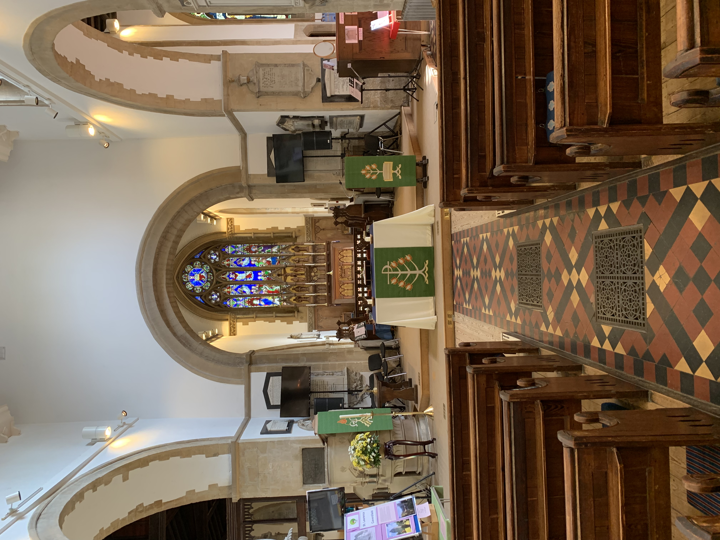

Slide 3
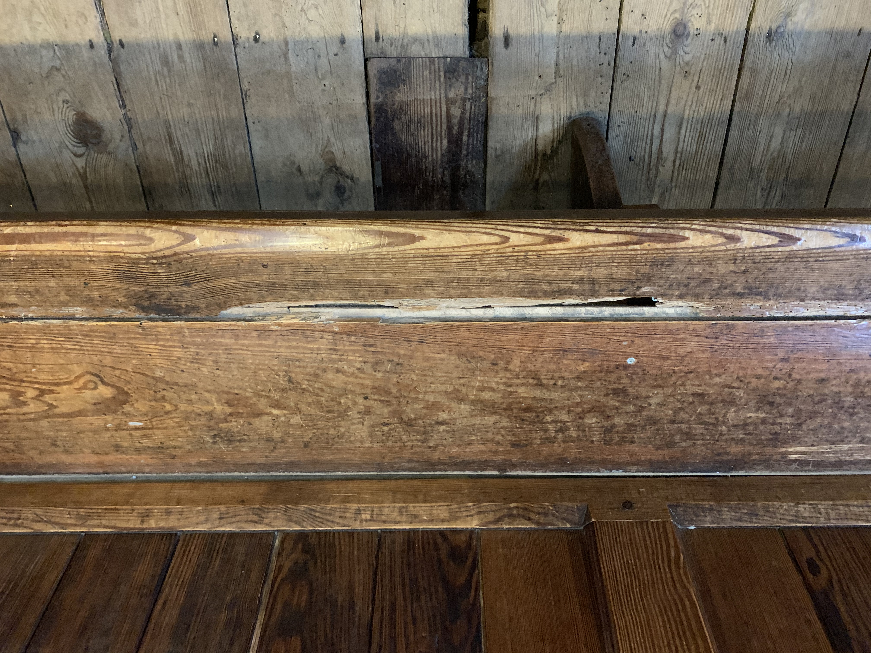
Damaged pew and floor

Slide 4
Damaged pew

Slide 5
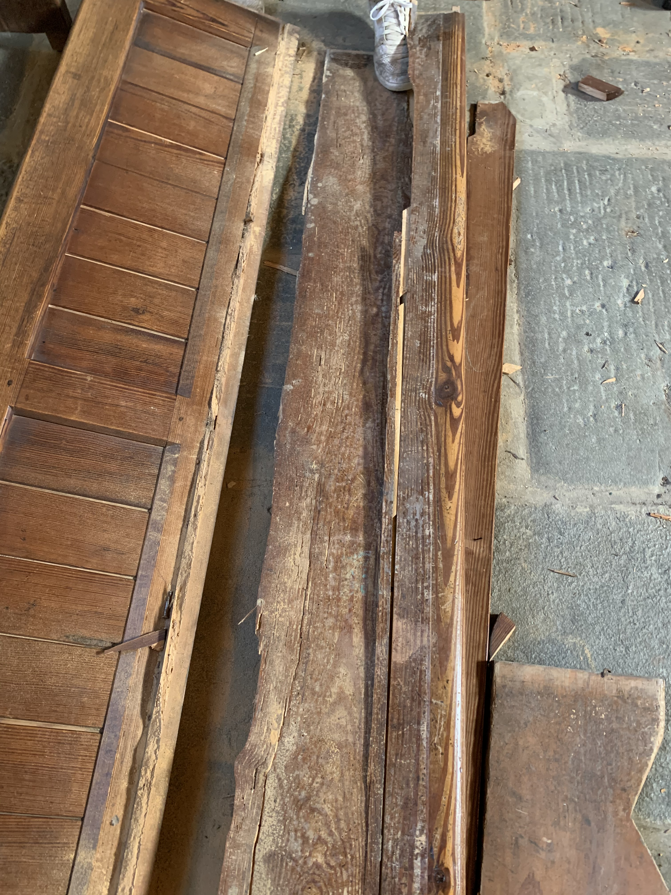
Pew literally fell apart

Slide 6
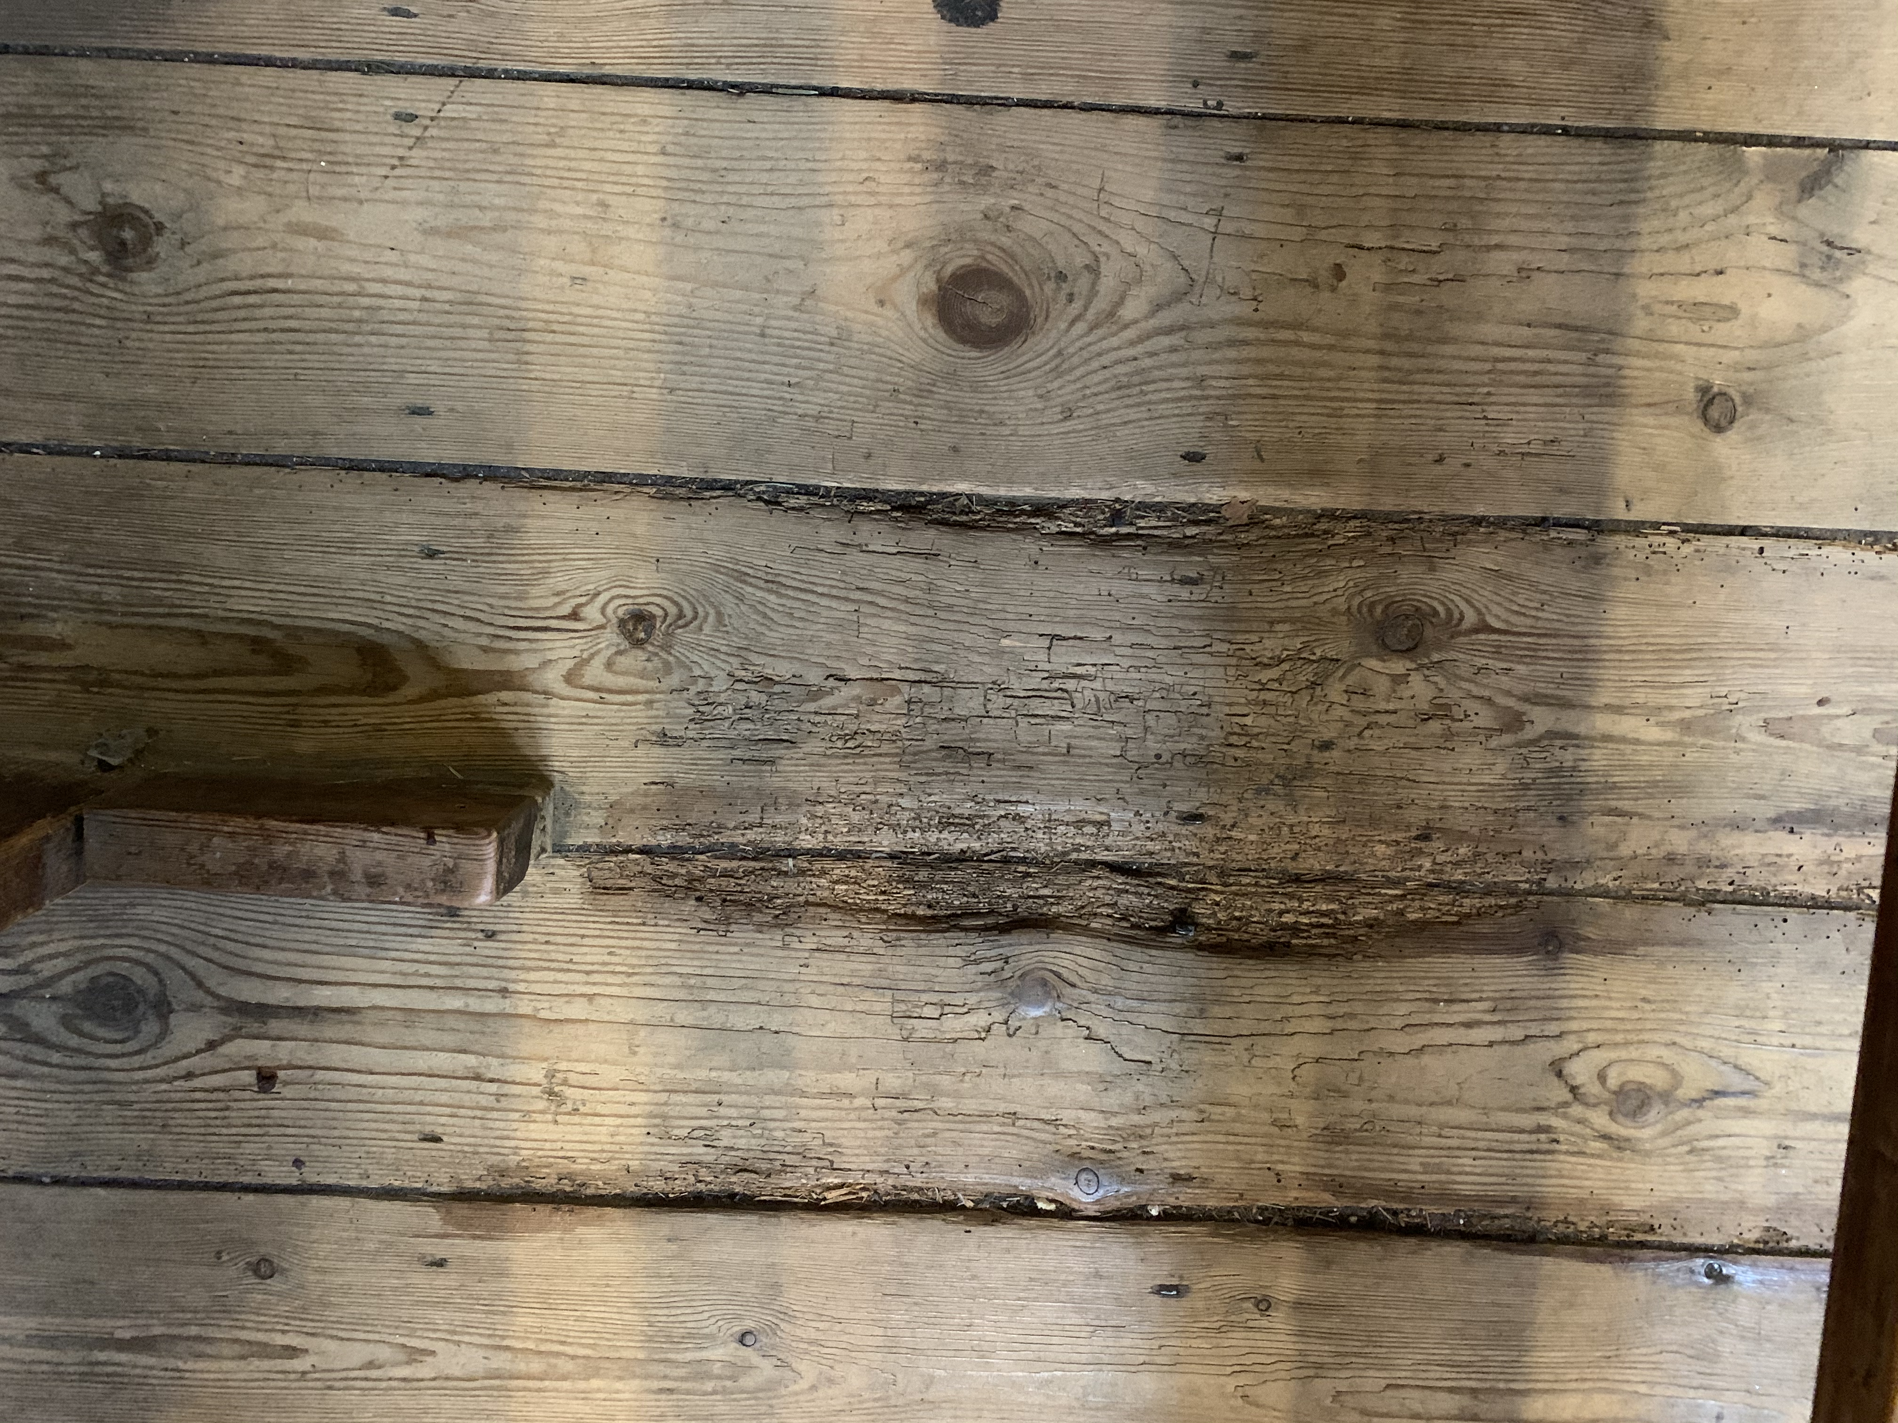
Rotting floorboard

Slide 7
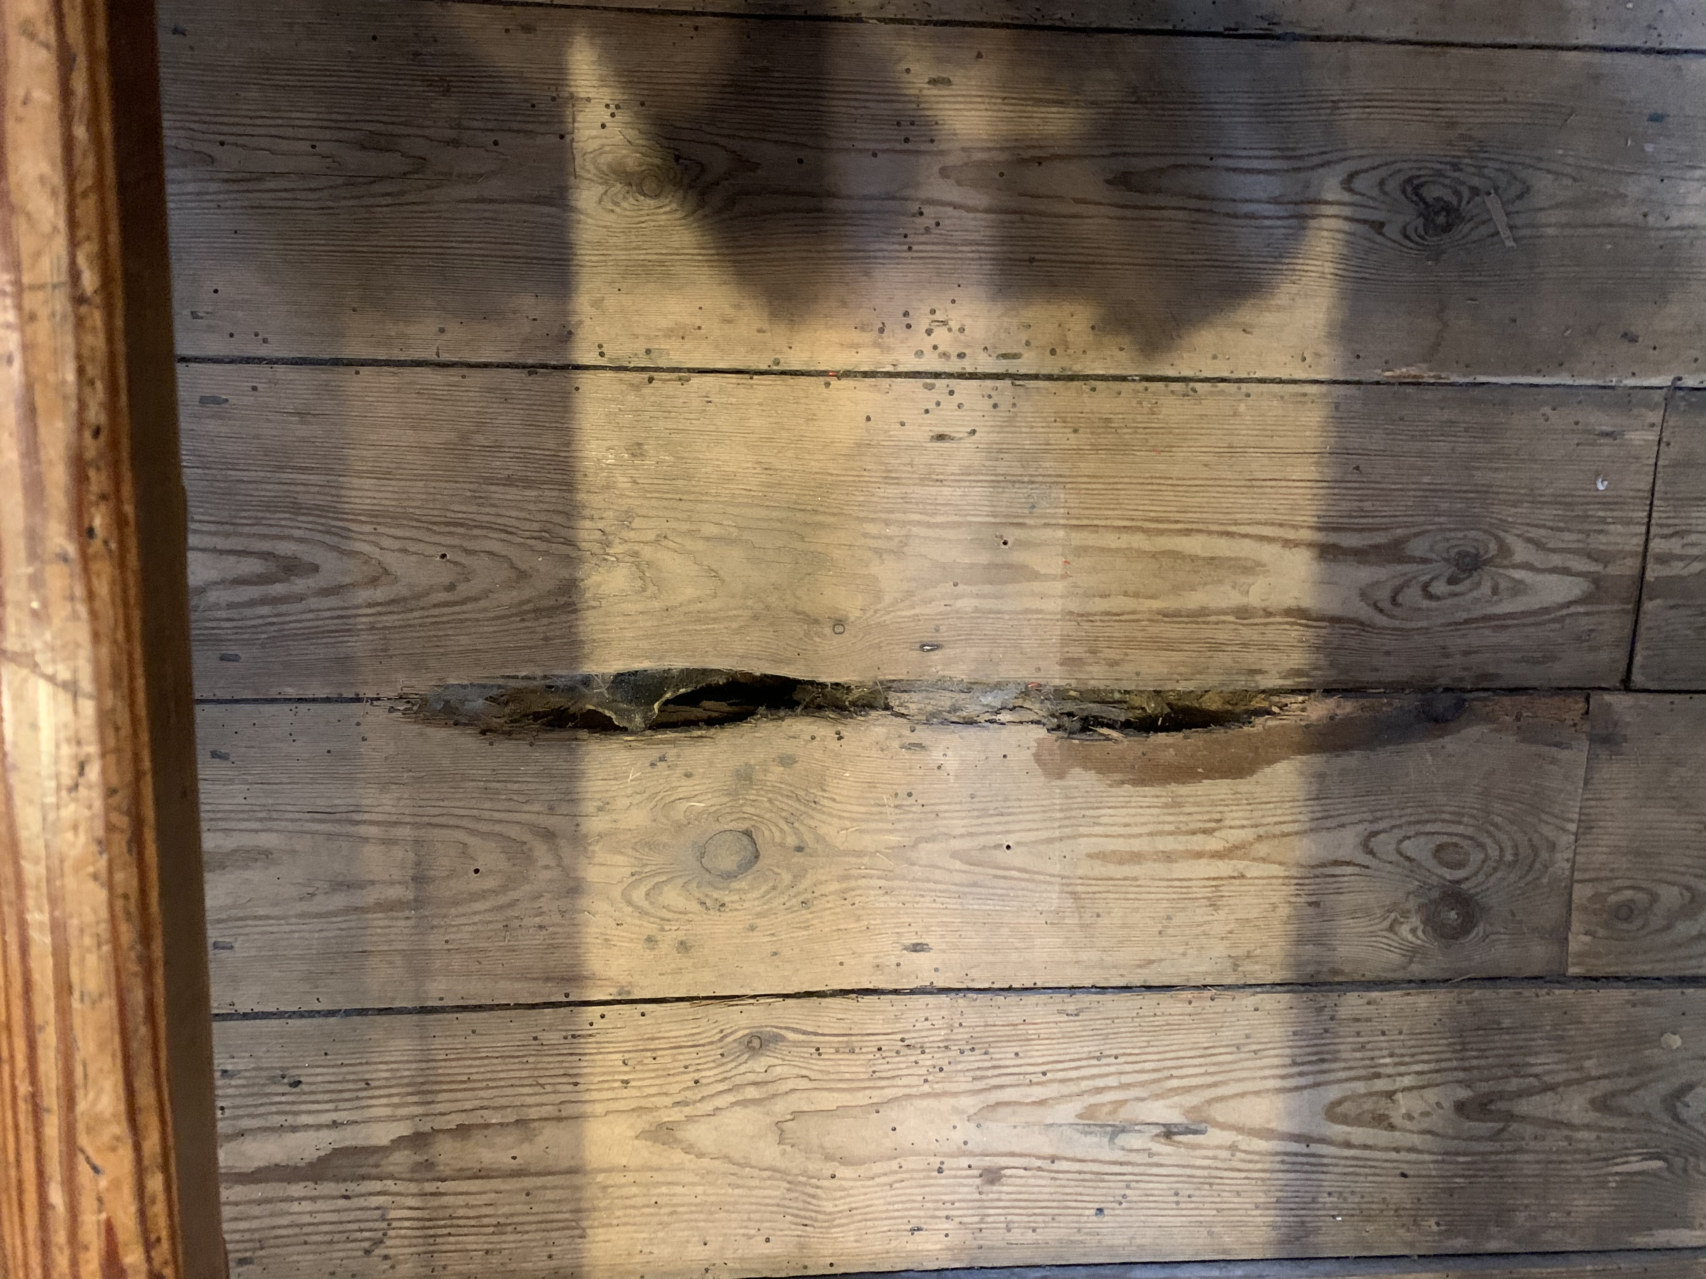
Rotting floorboard

Slide 8
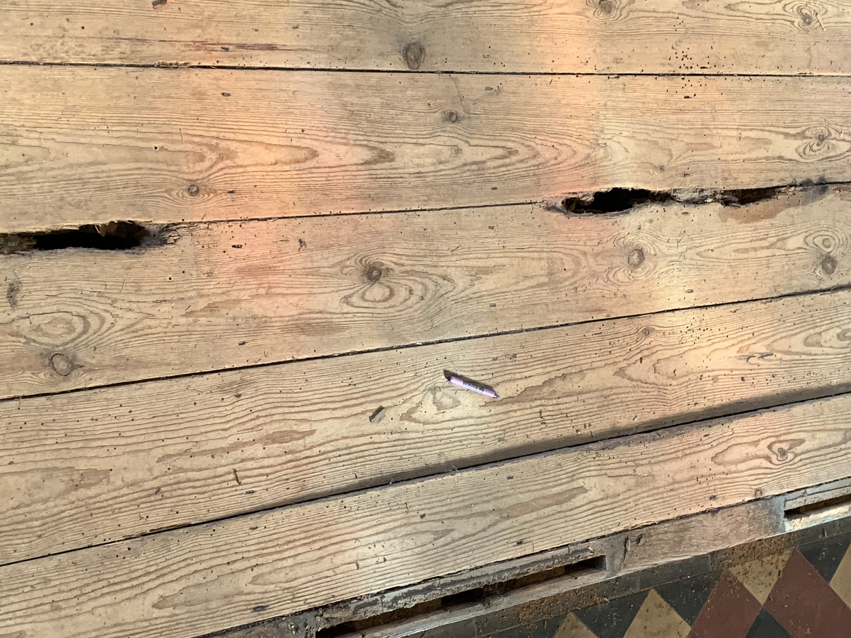
Rotting floorboard

Slide 9
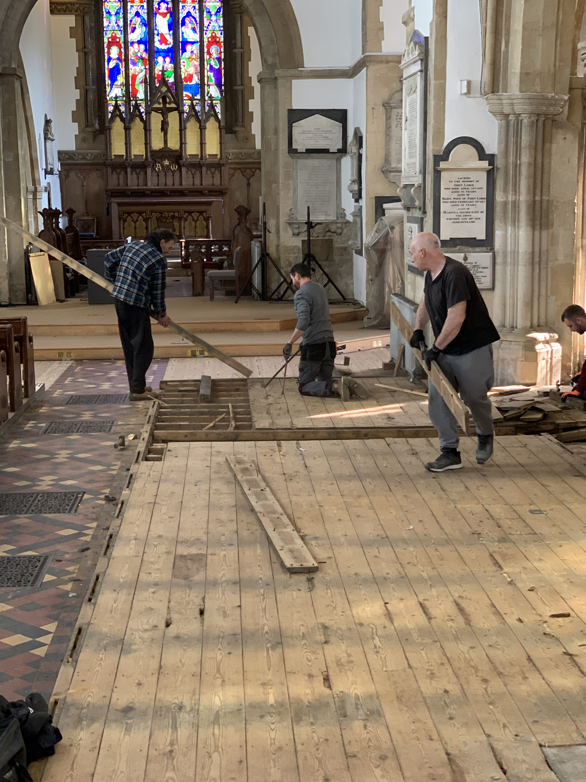
Removal of floorboards

Slide 10
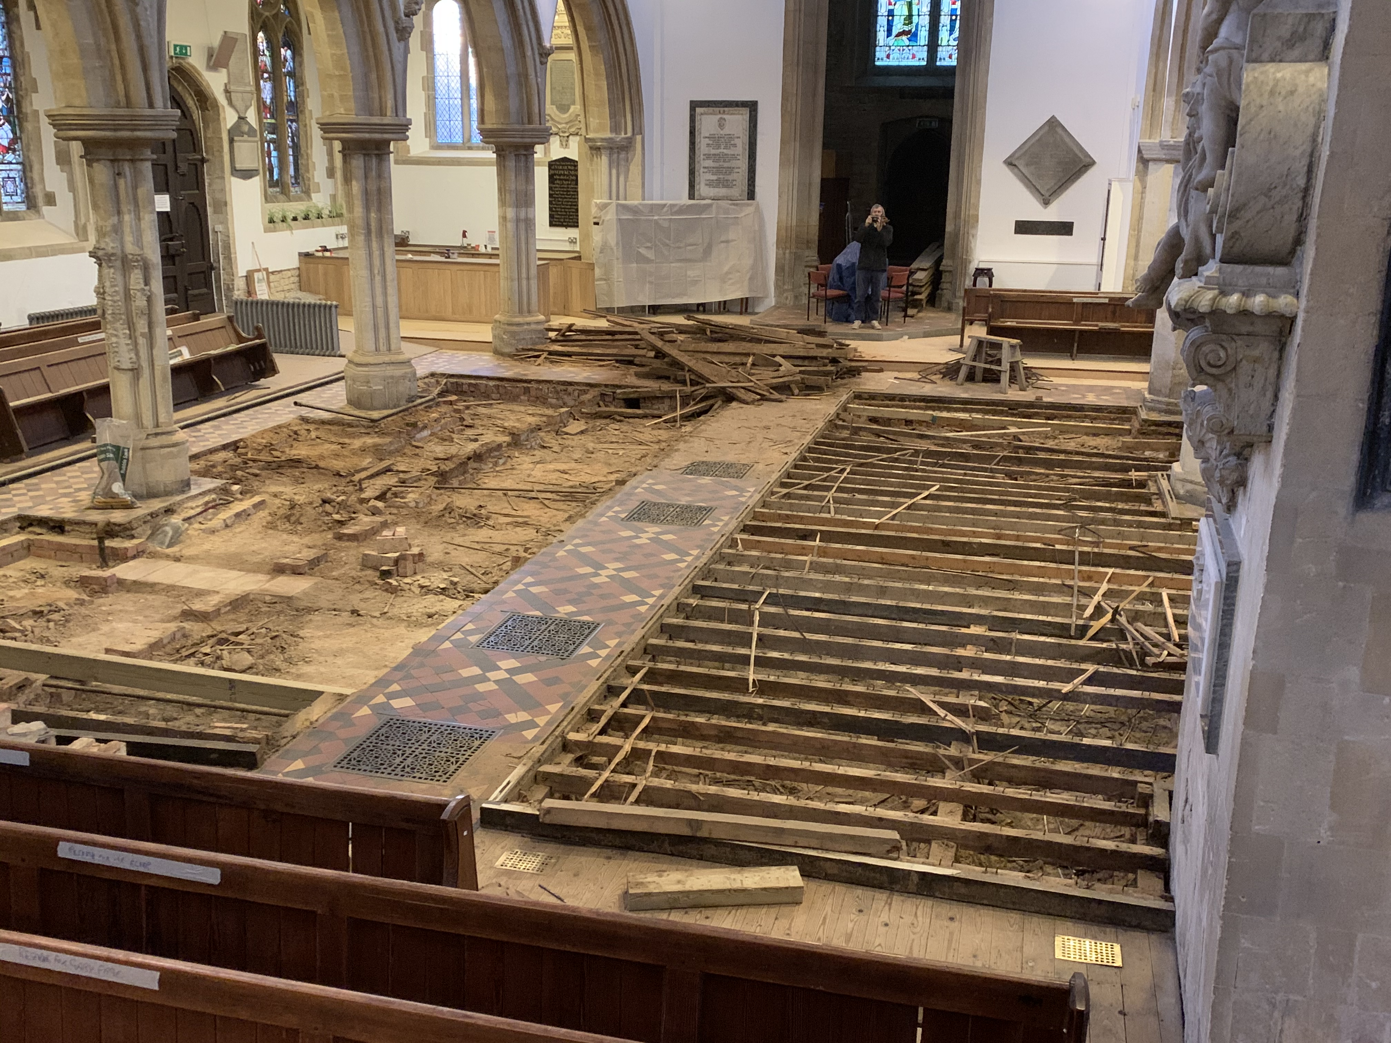

Slide 11
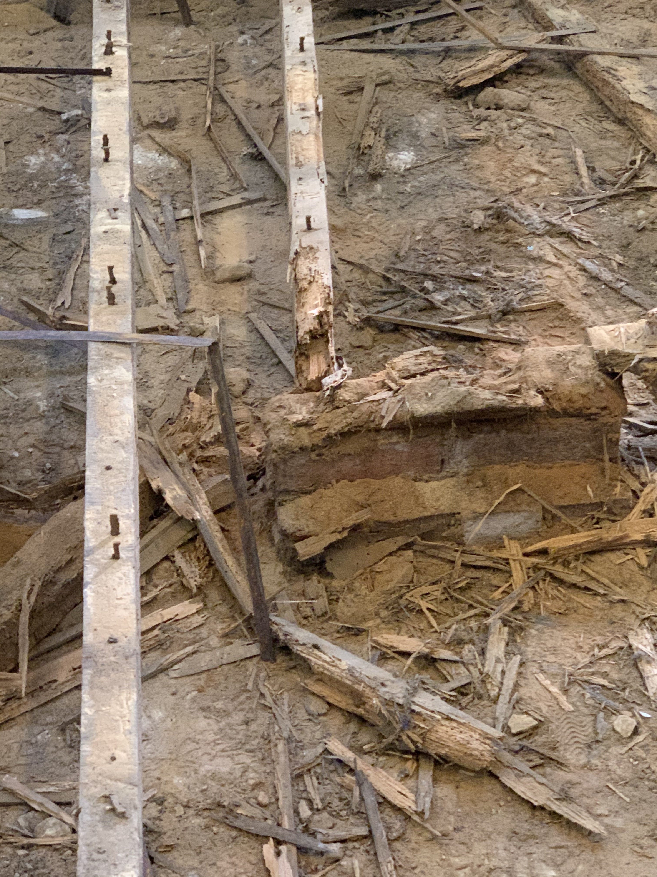
Rotting floor joist

Slide 12
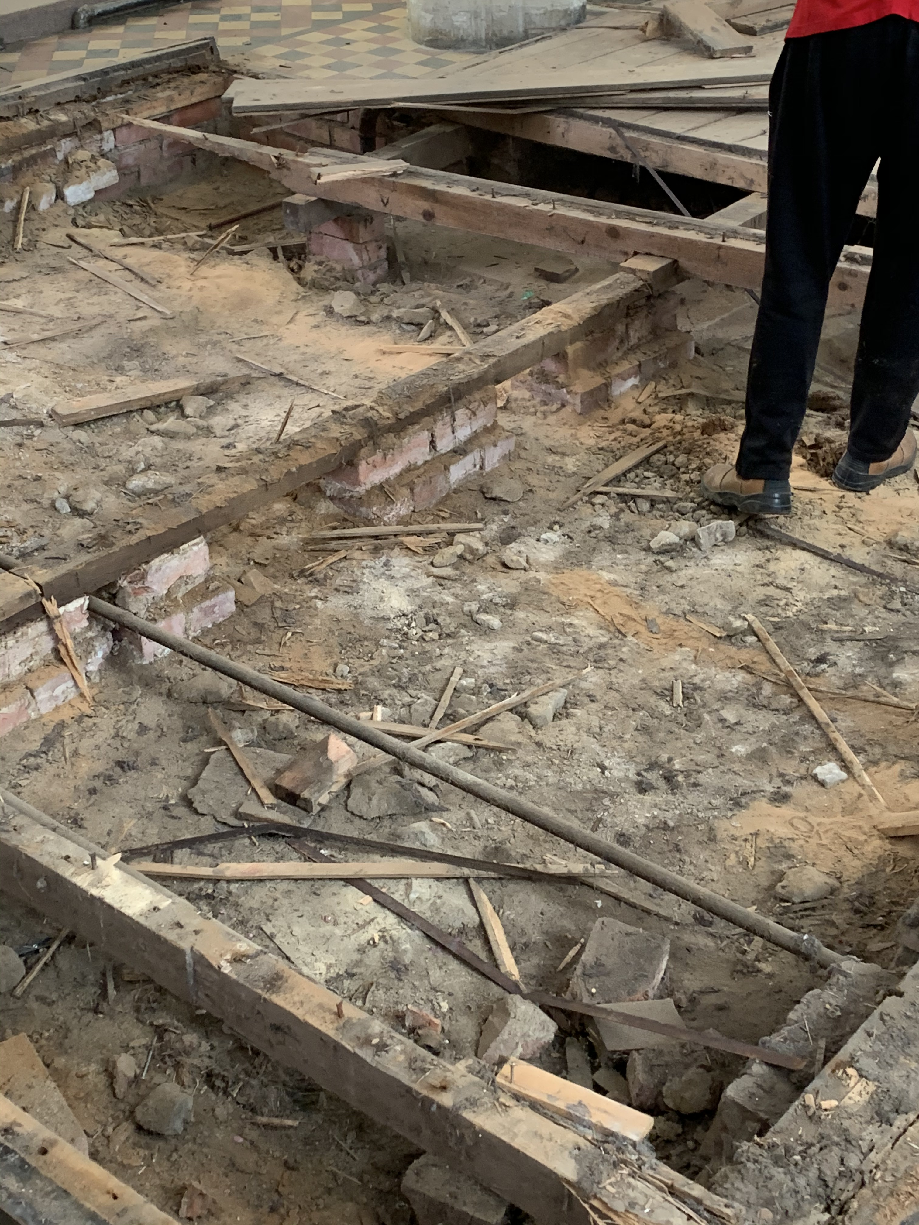
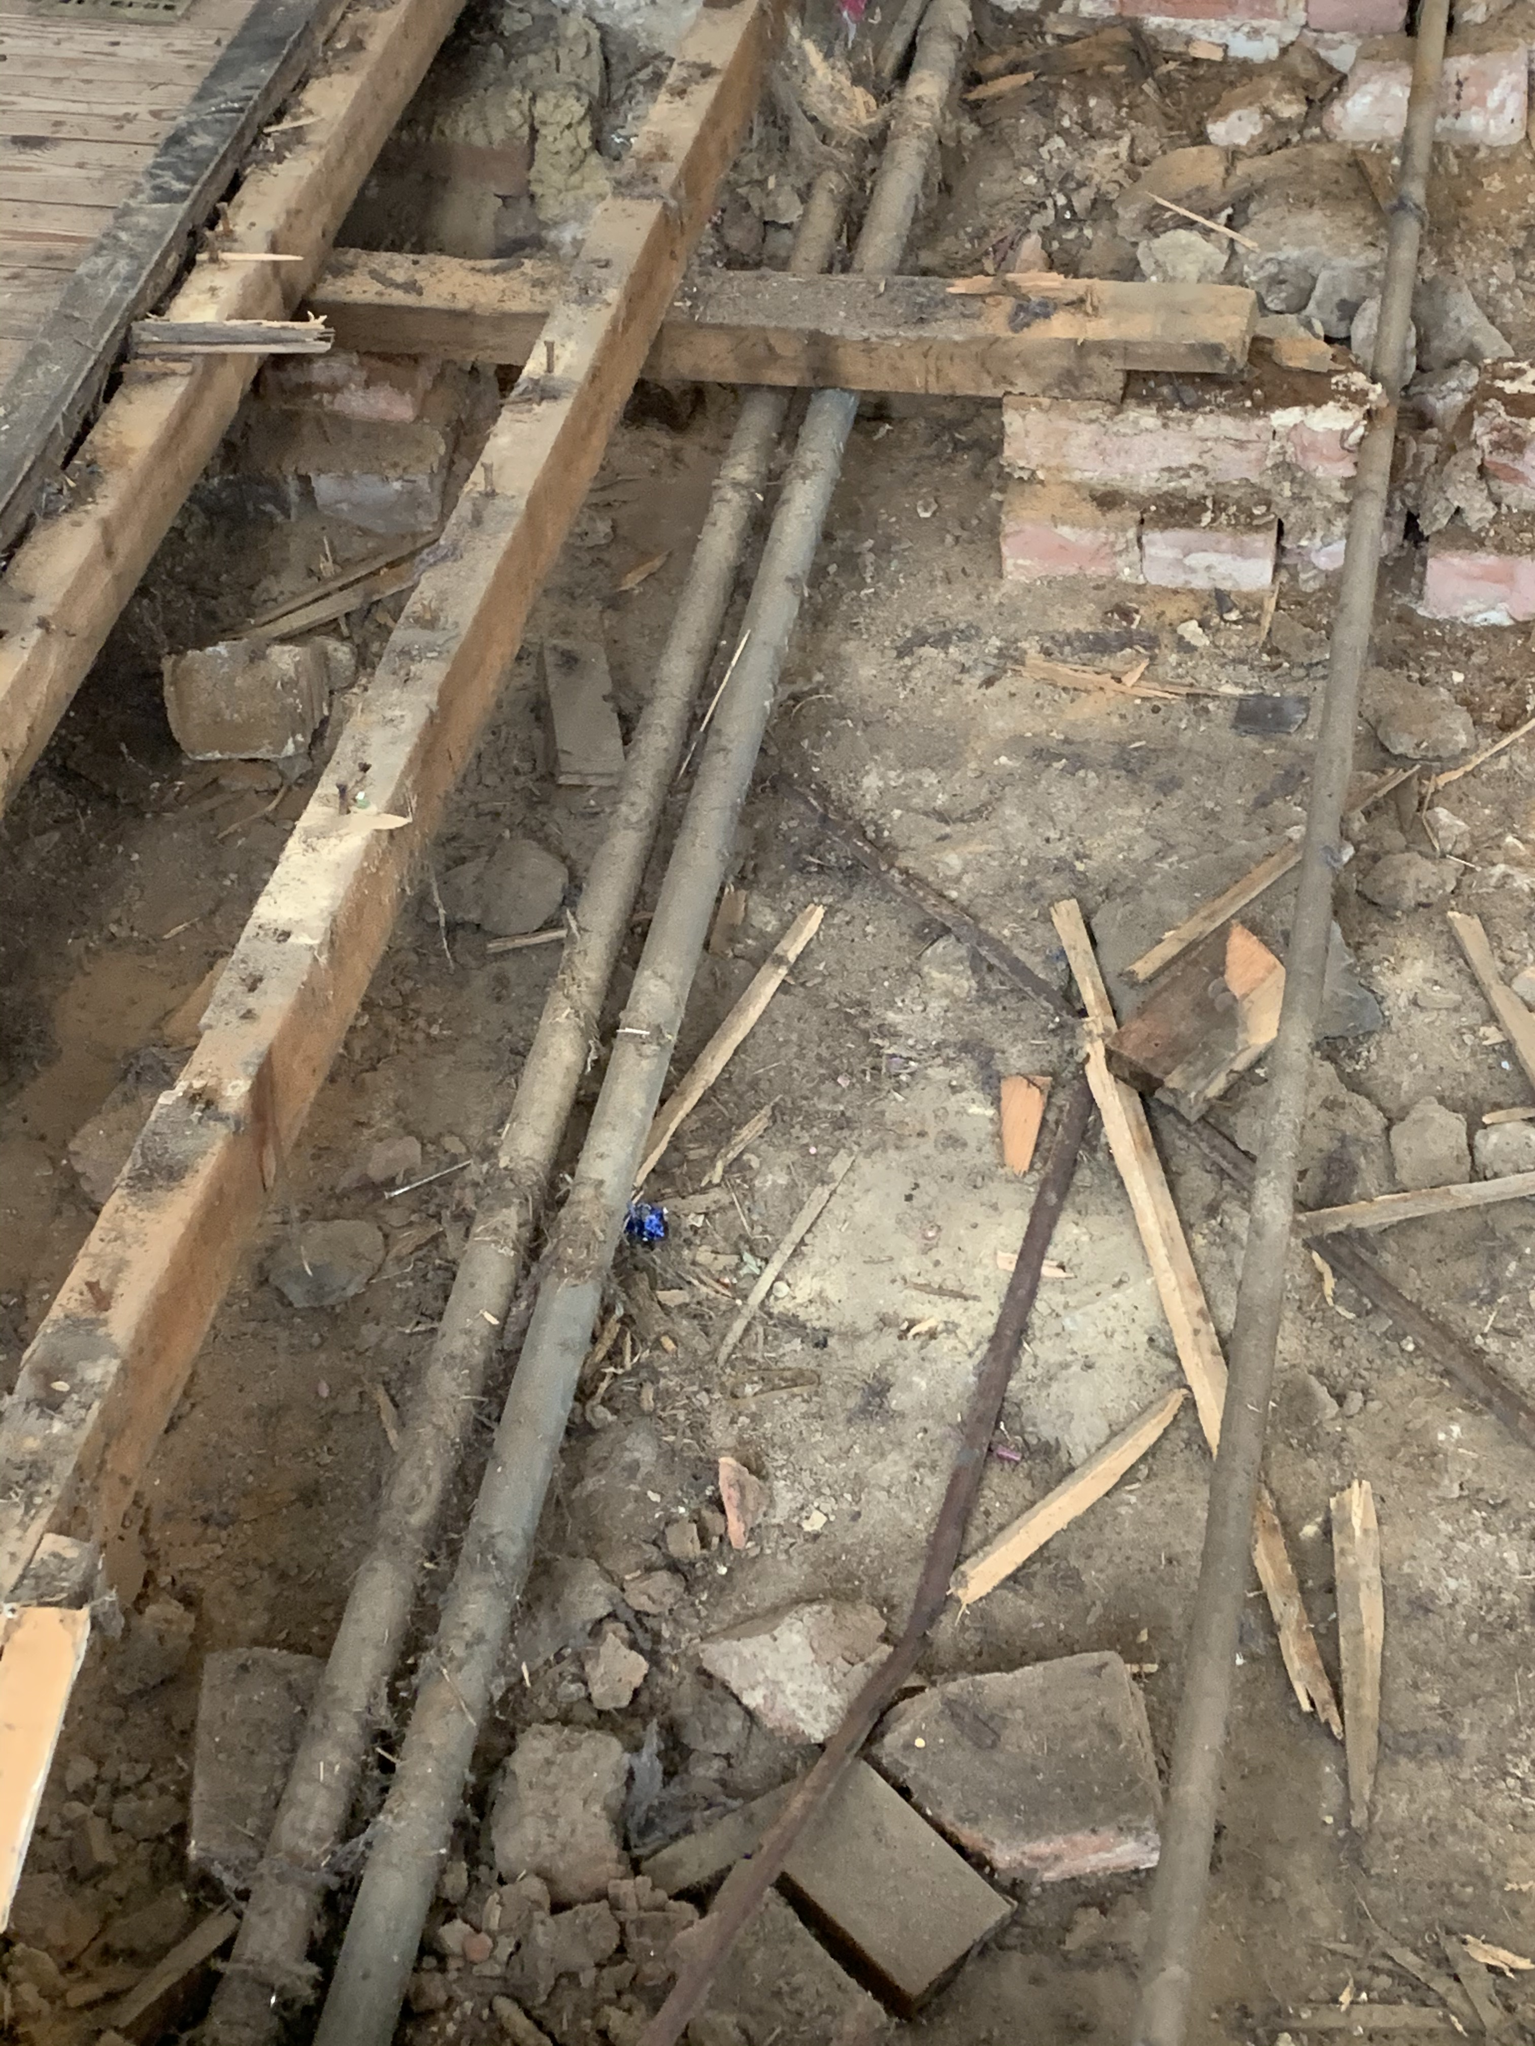
Pipe for gas lighting
Heating pipes

Slide 13
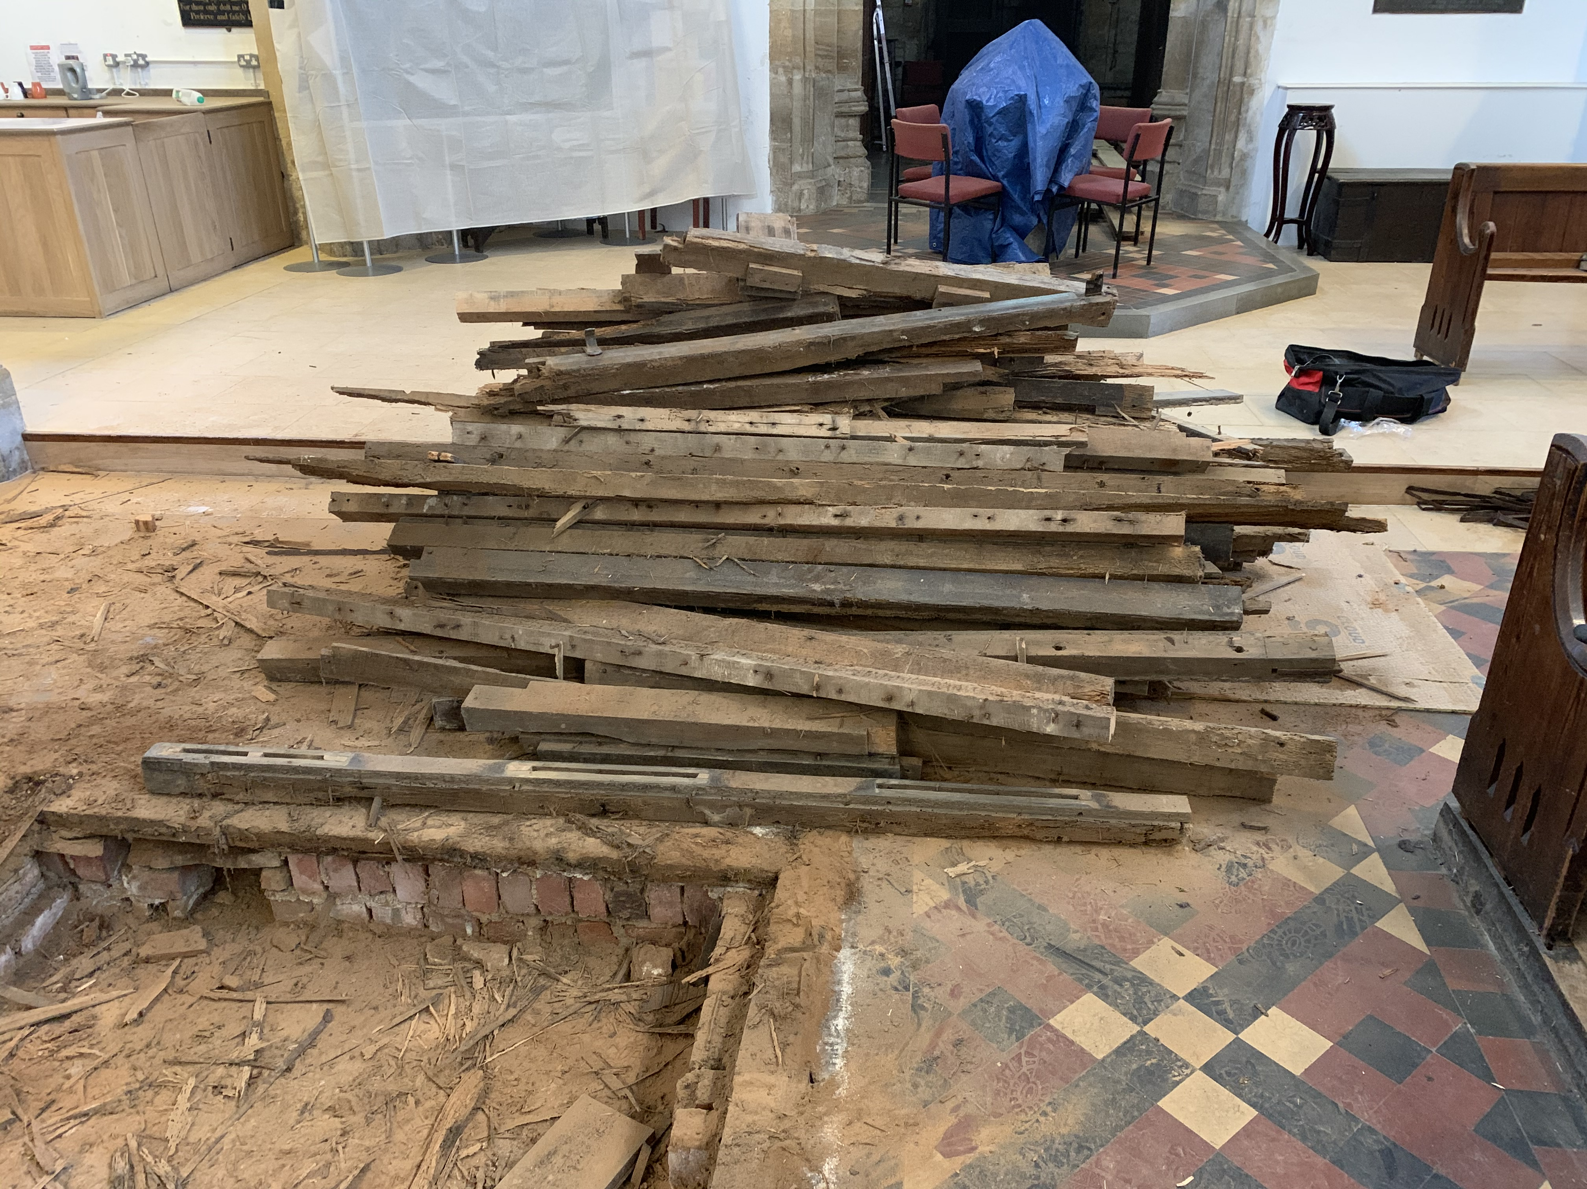
Old joists

Slide 14
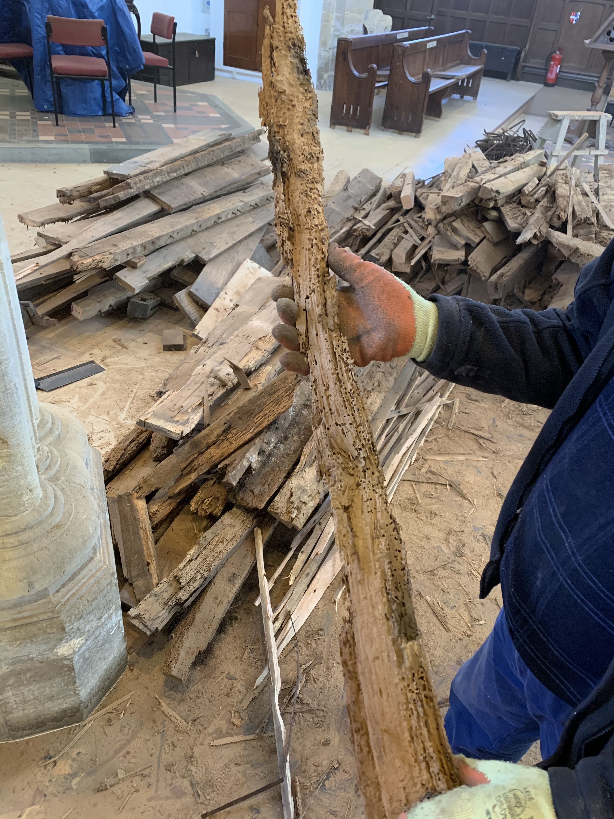
Rotten joist !!

Slide 15
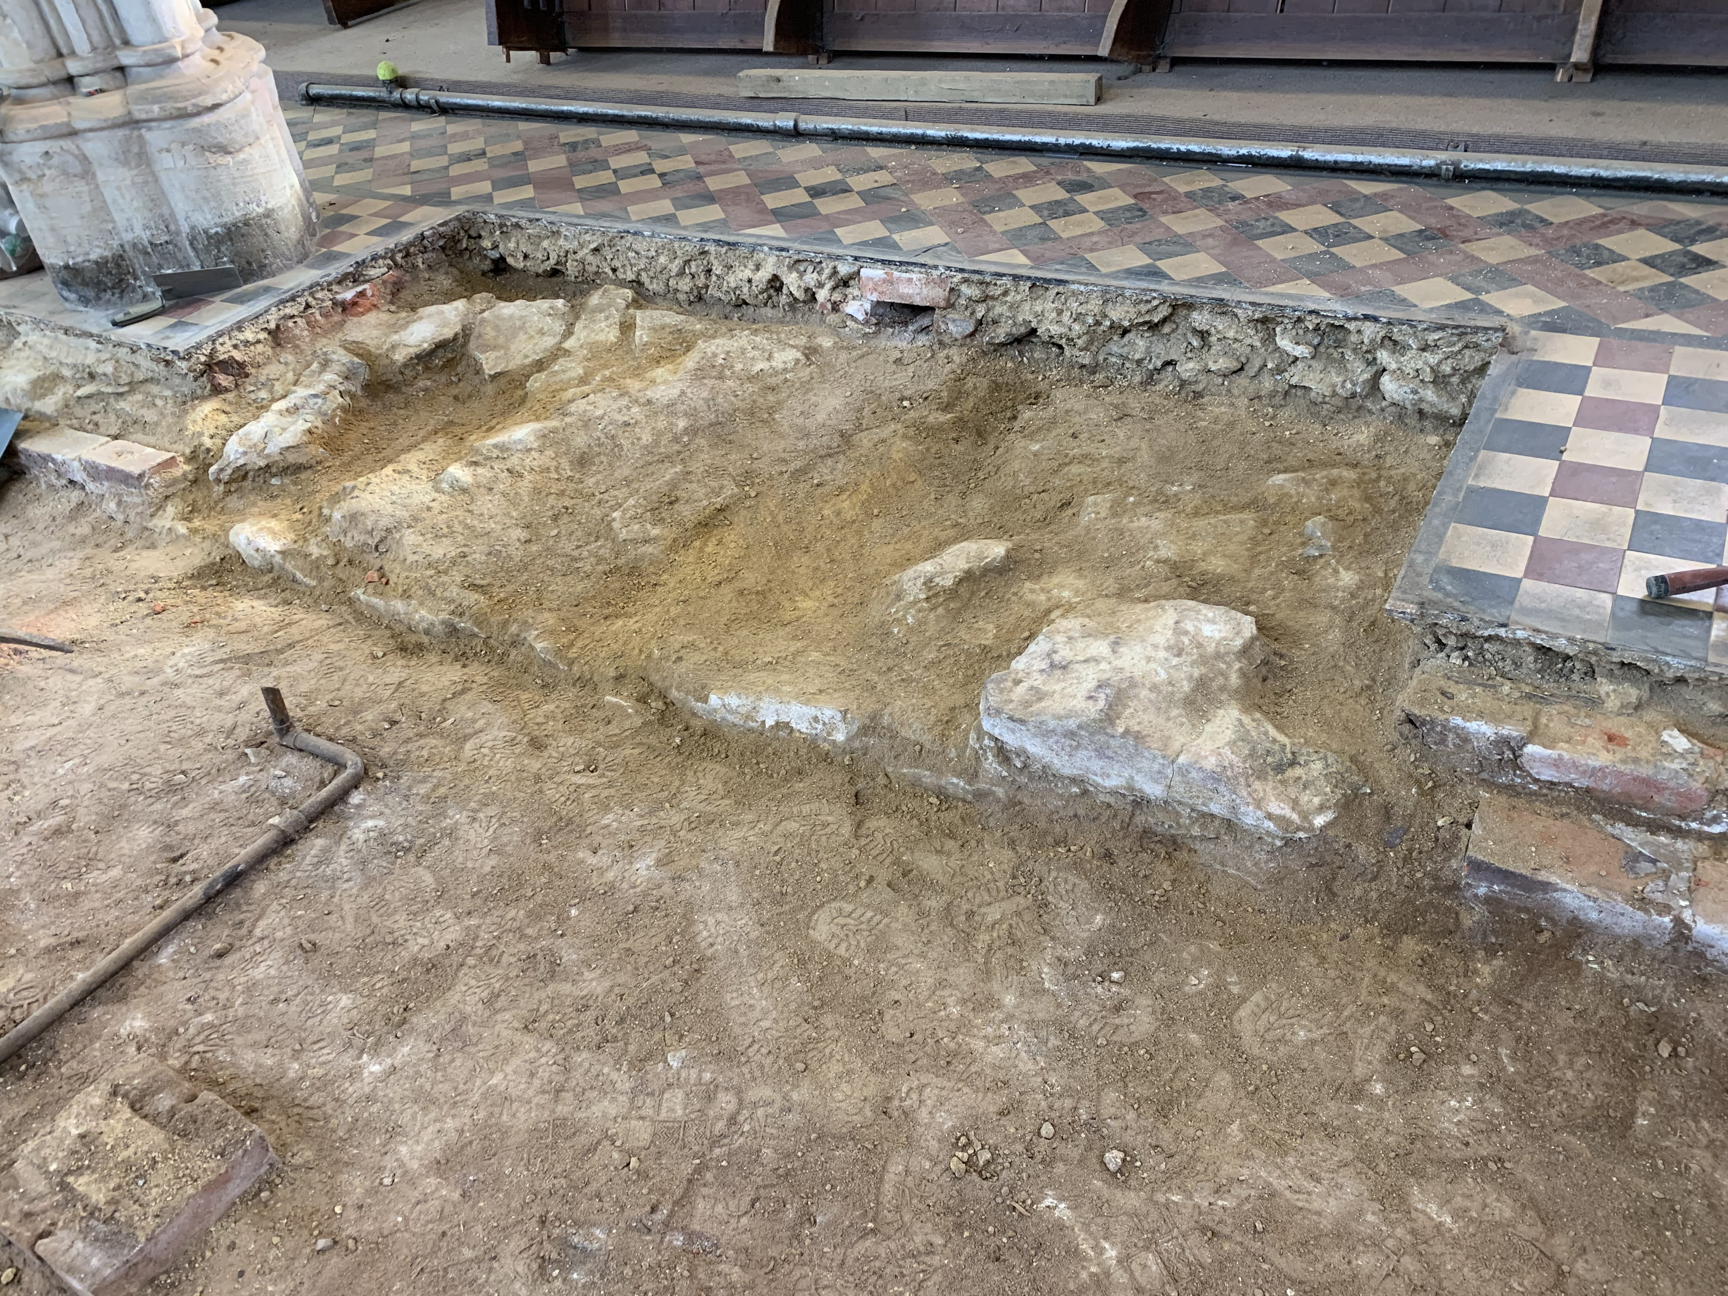
Foundation stones from 1120AD Church

Slide 16
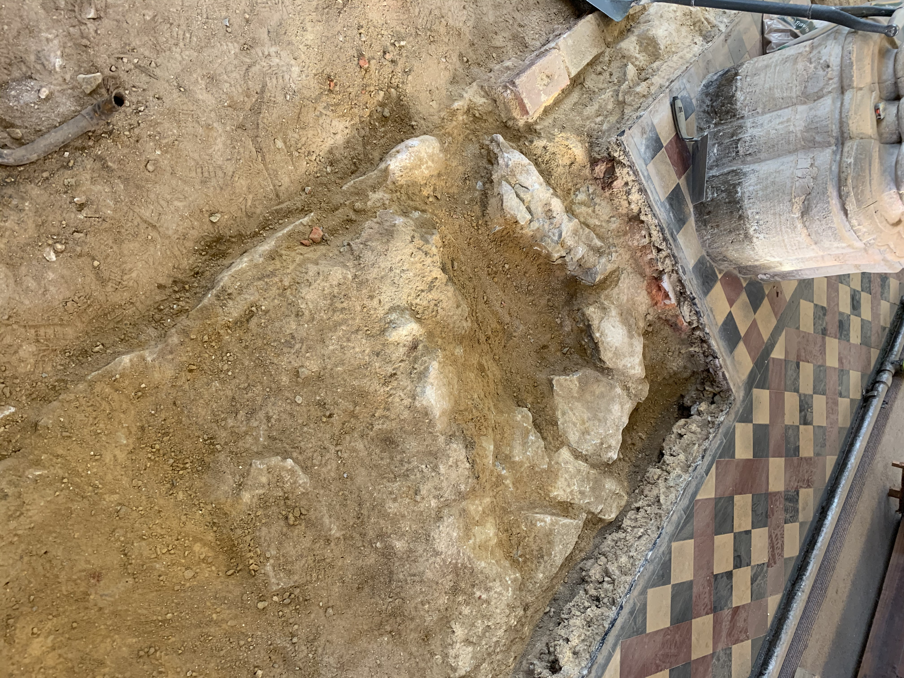
Foundation stones from 1120AD Church

Slide 17
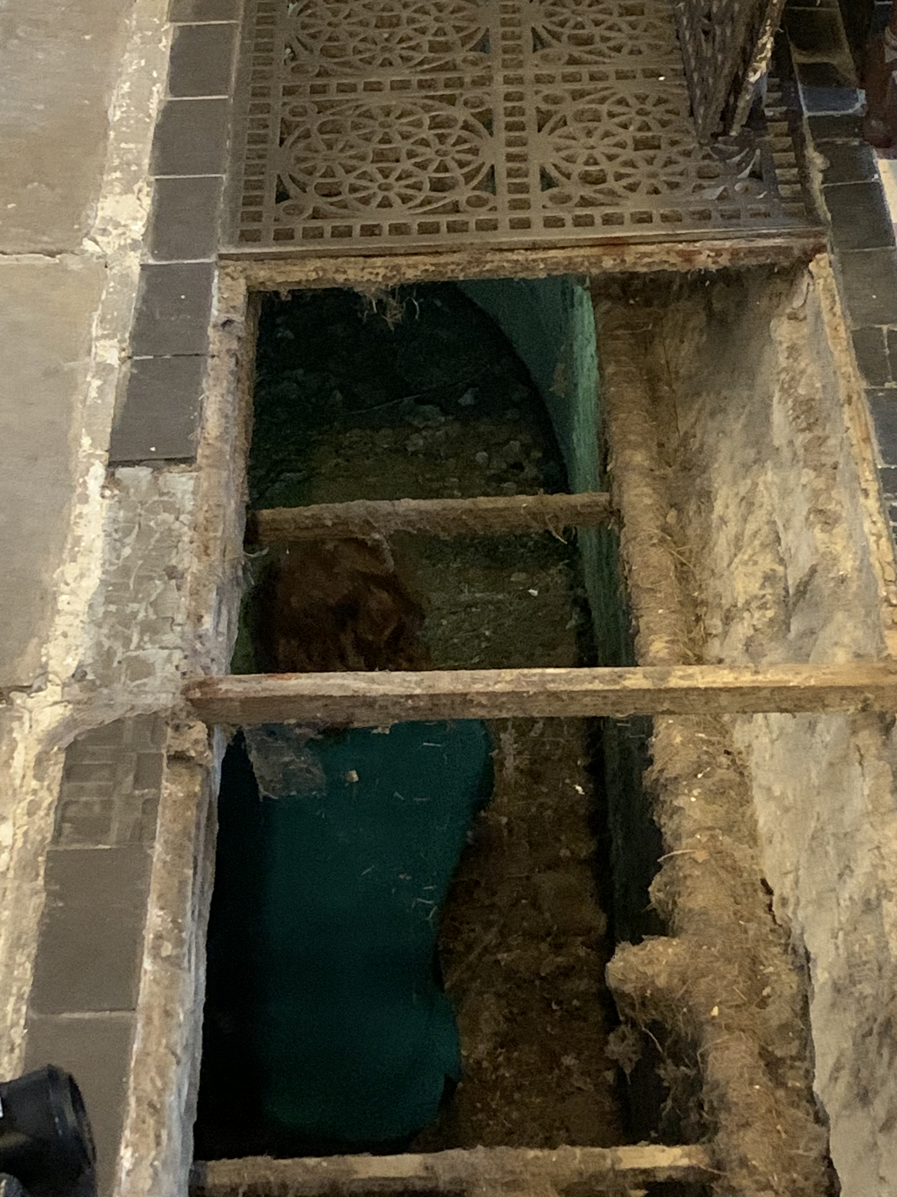
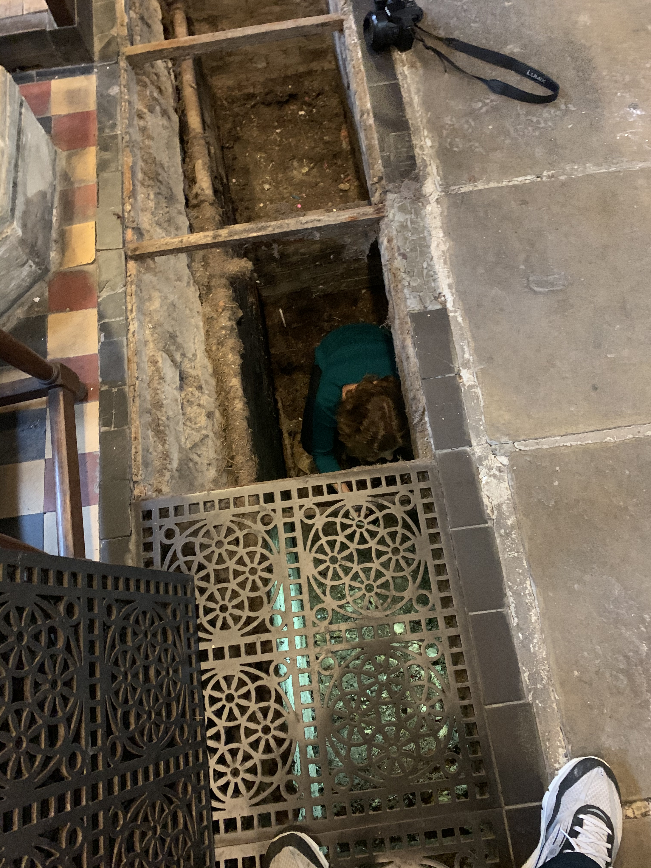
Channel as part of a very early warm air heating systems

Slide 18
Stone with silver plaque
Robert Smith: died 7th Feb 1837 aged 22yrs

Slide 20
Memorial for Robert Smith’s father & mother
Rector of the Church 1800 - 1835
Memorial for Robert Smith

Slide 21
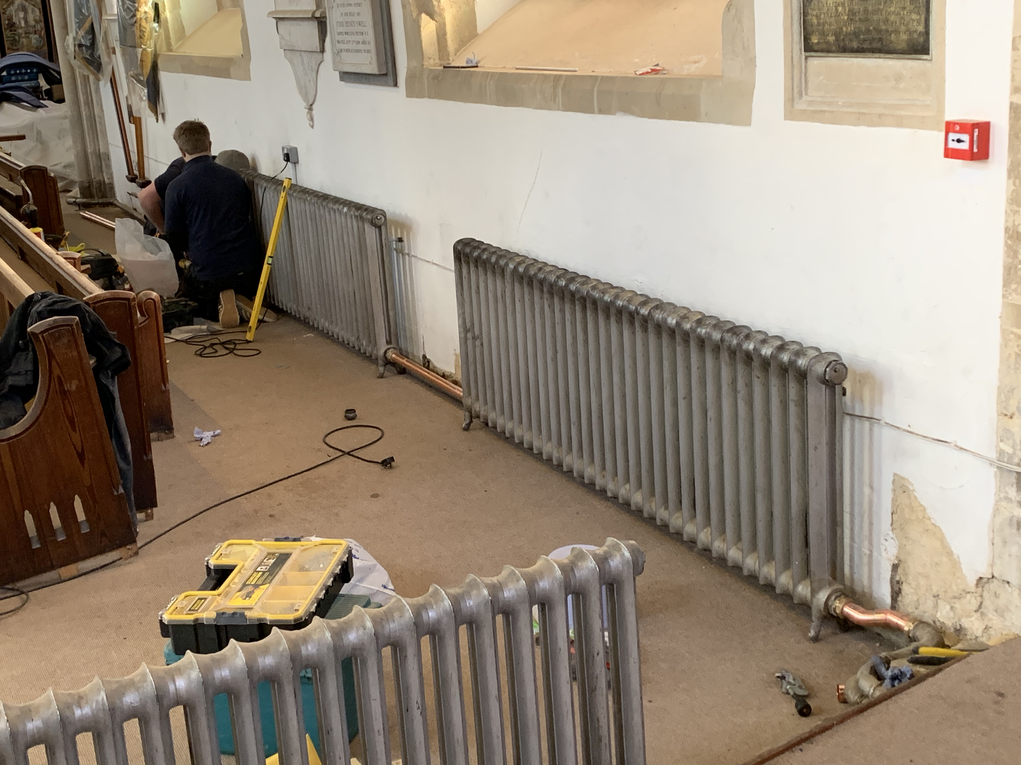
Radiators moved to south wall

Slide 22
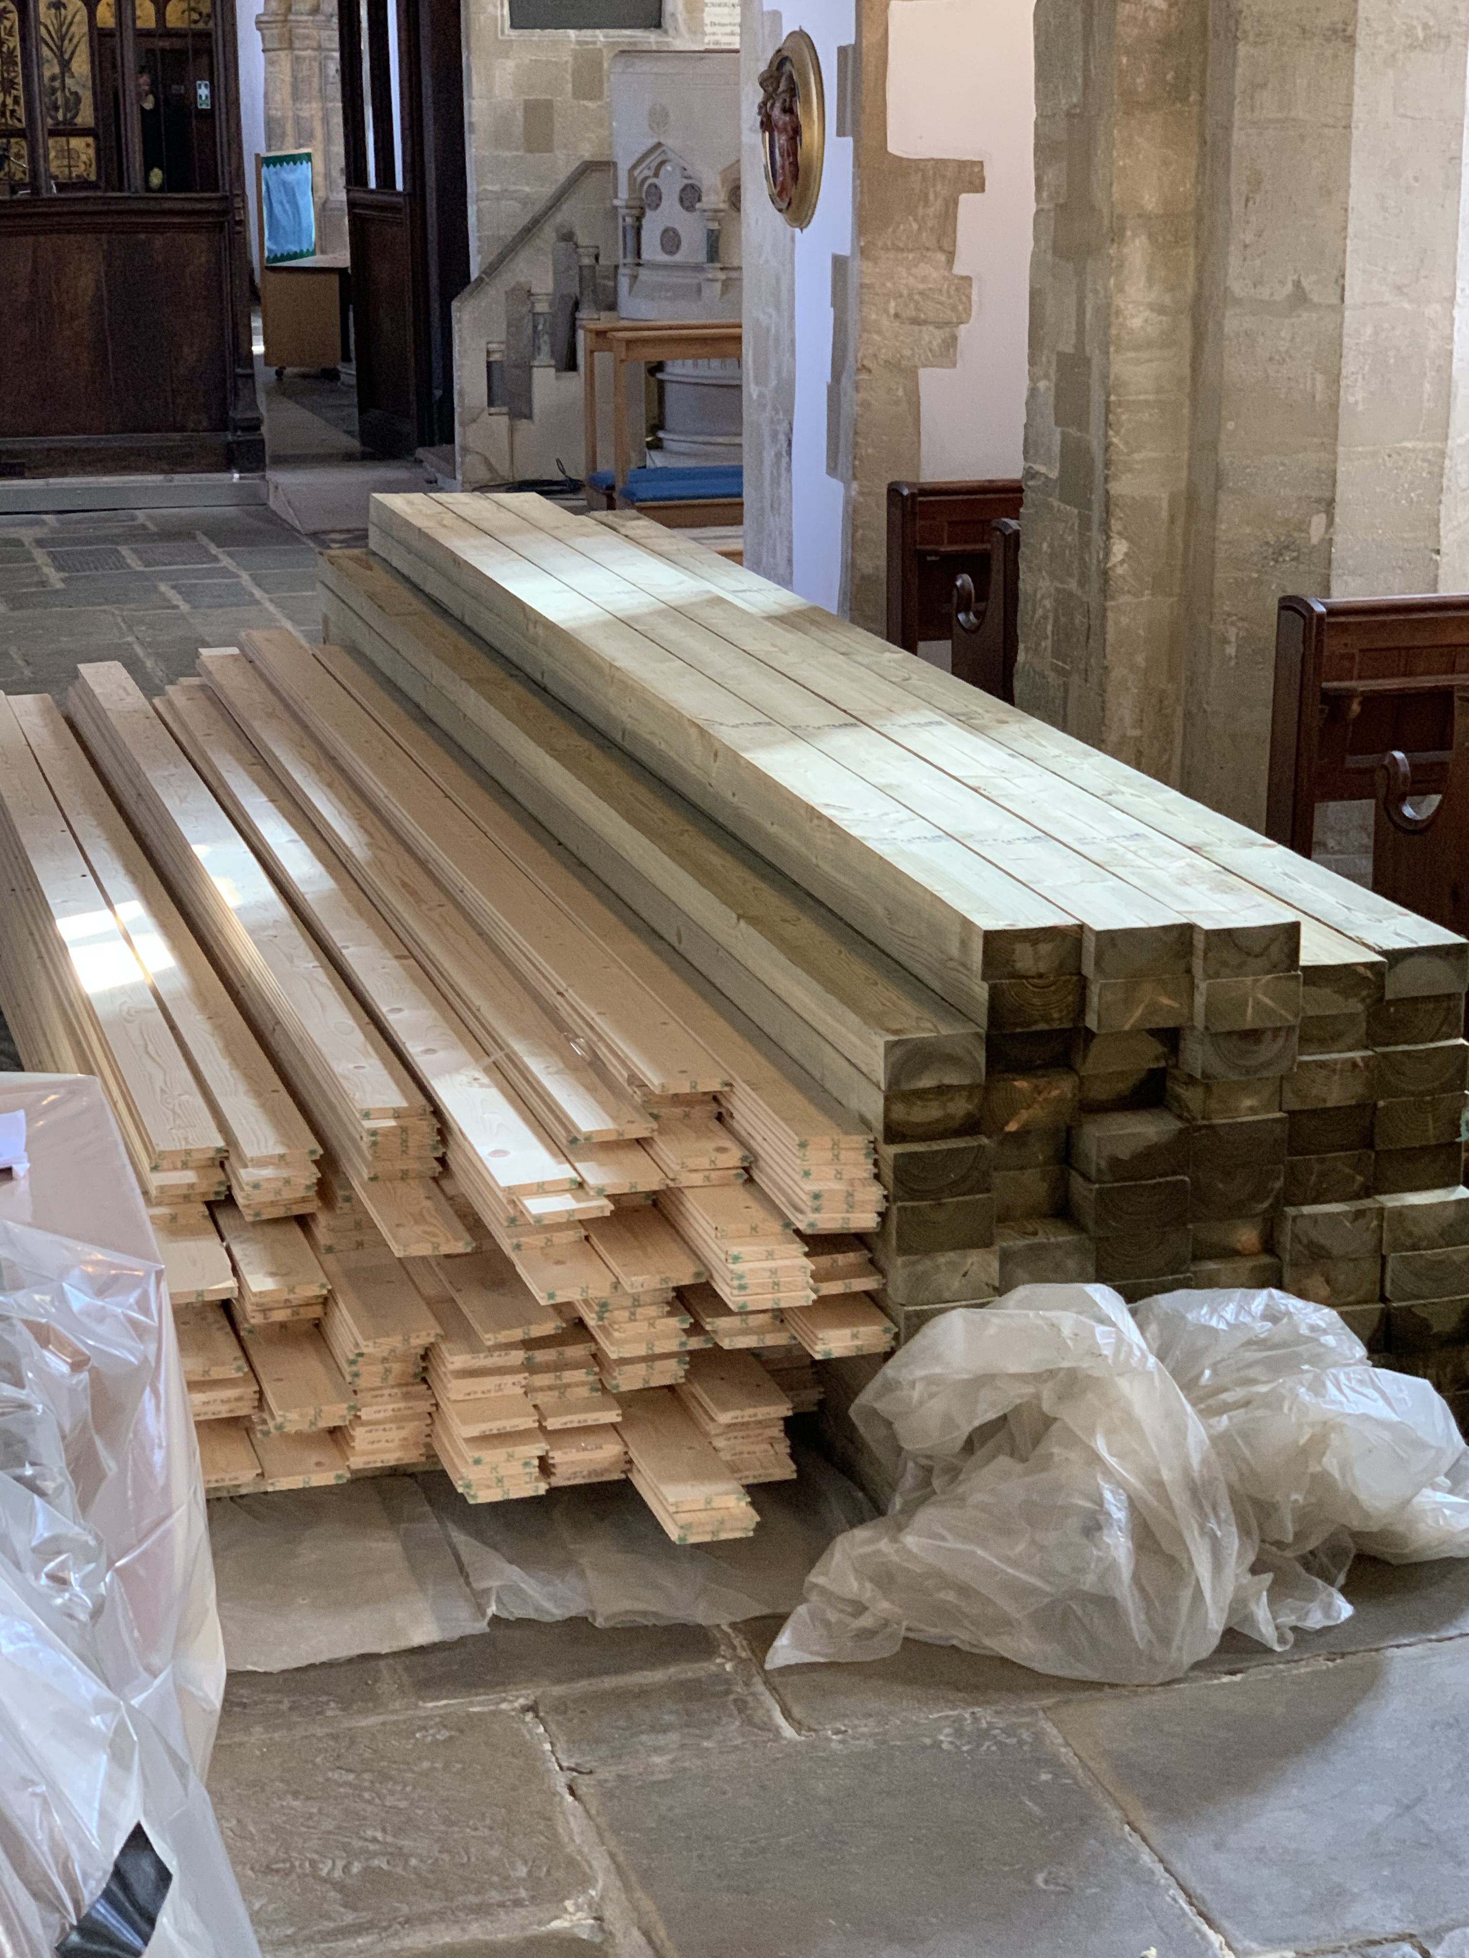
New floor arrives

Slide 23
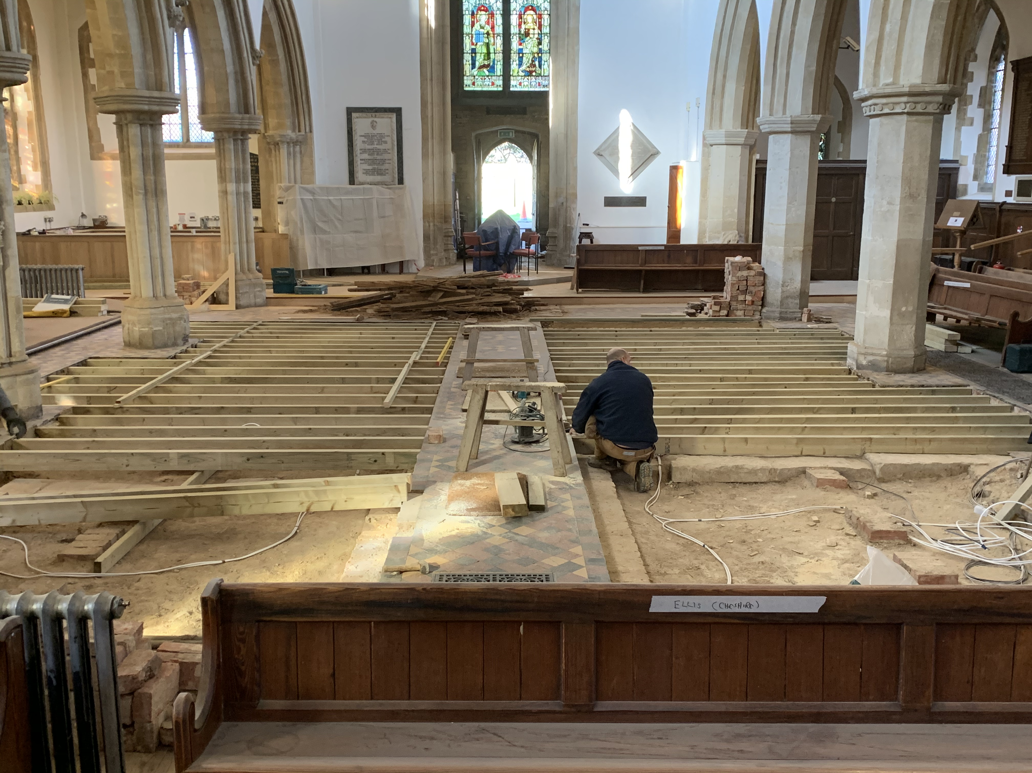
New joists being fitted

Slide 24
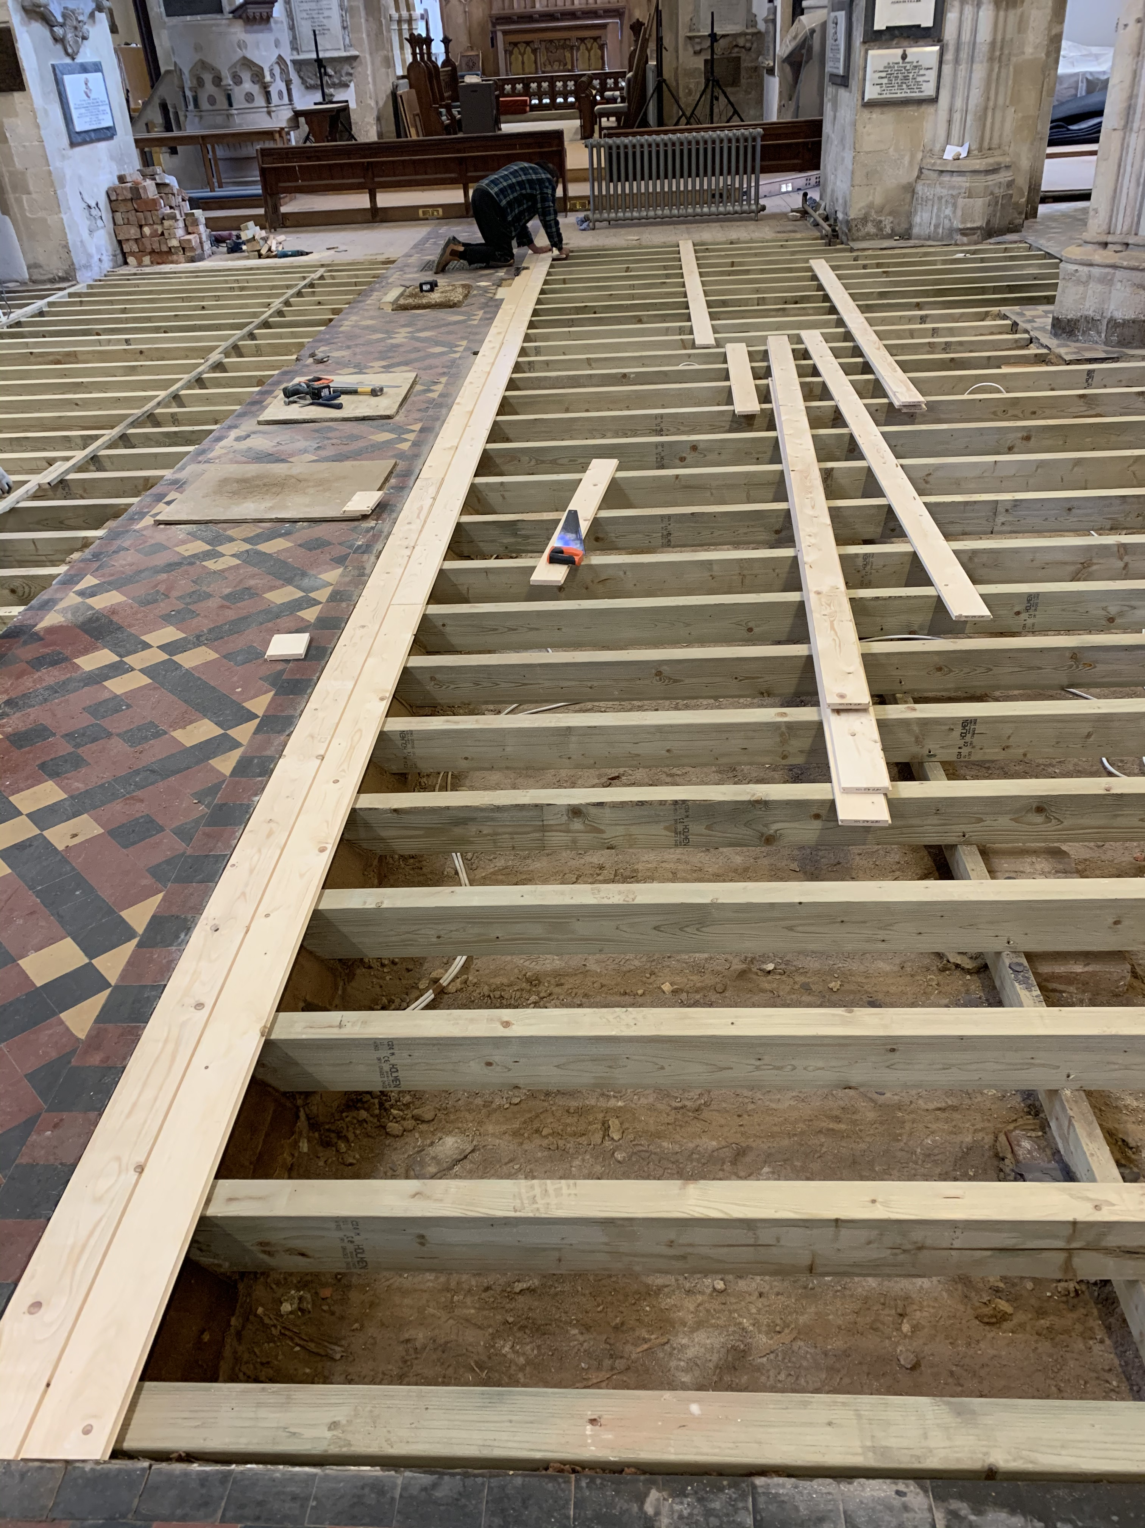
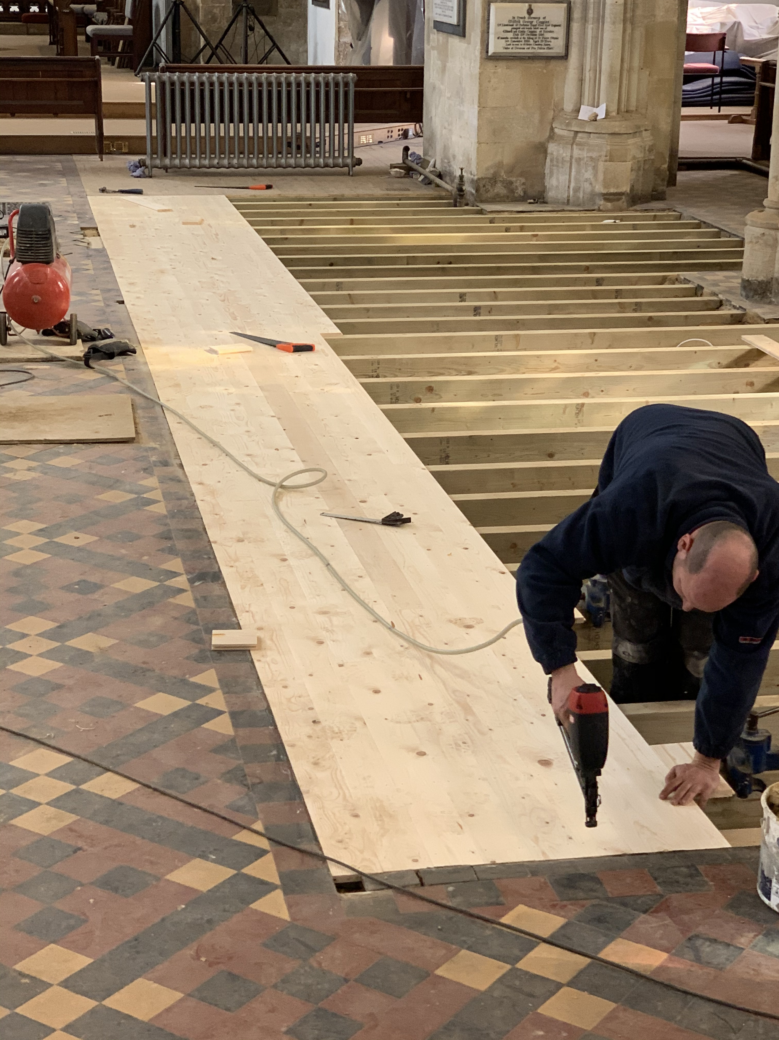
New floor going down

Slide 25
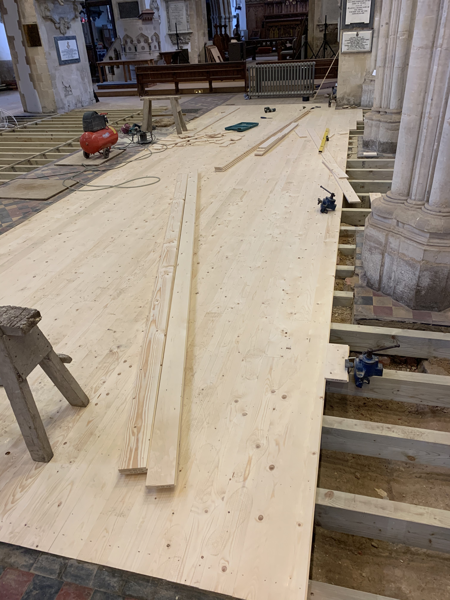

Slide 26
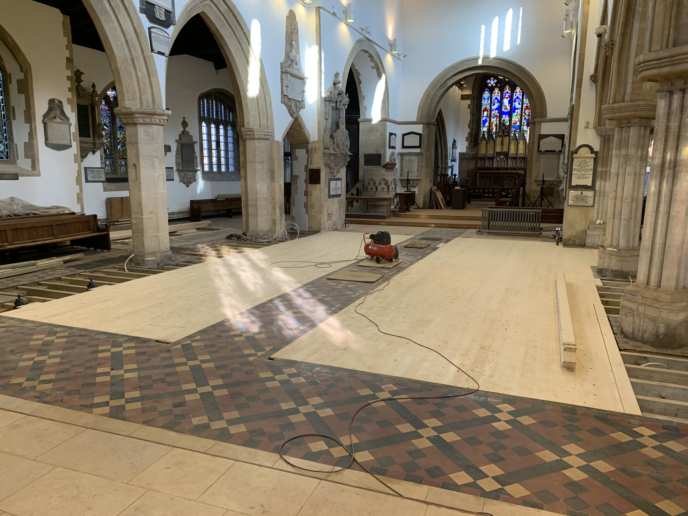

Slide 27
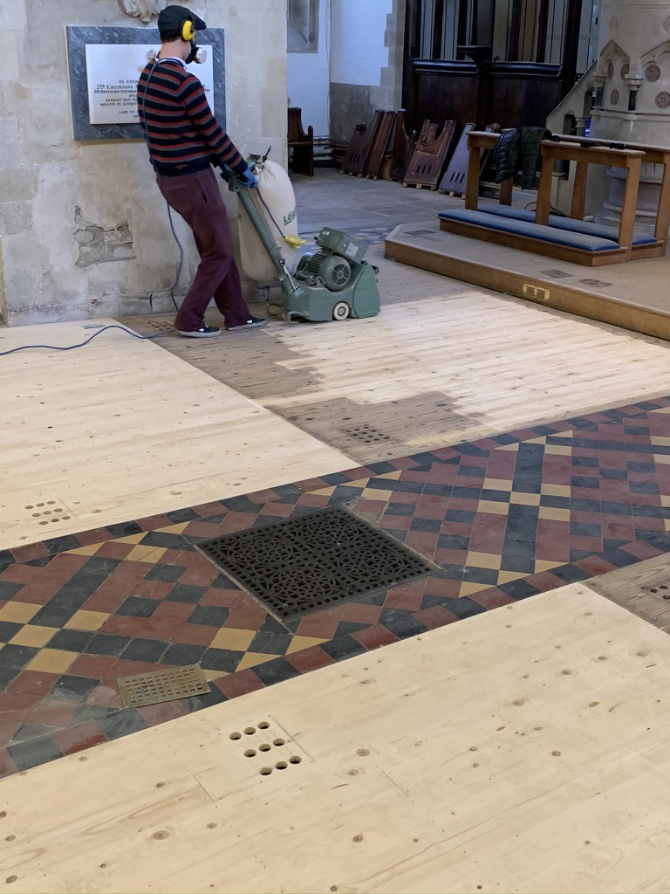
Sanding the floor – look at the difference on the old part!

Slide 28
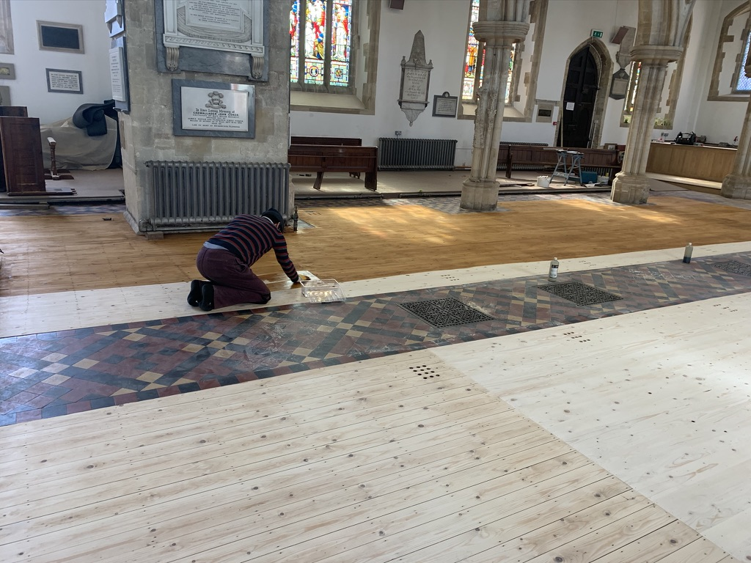
Staining the floor – took 3.5 hours

Slide 29
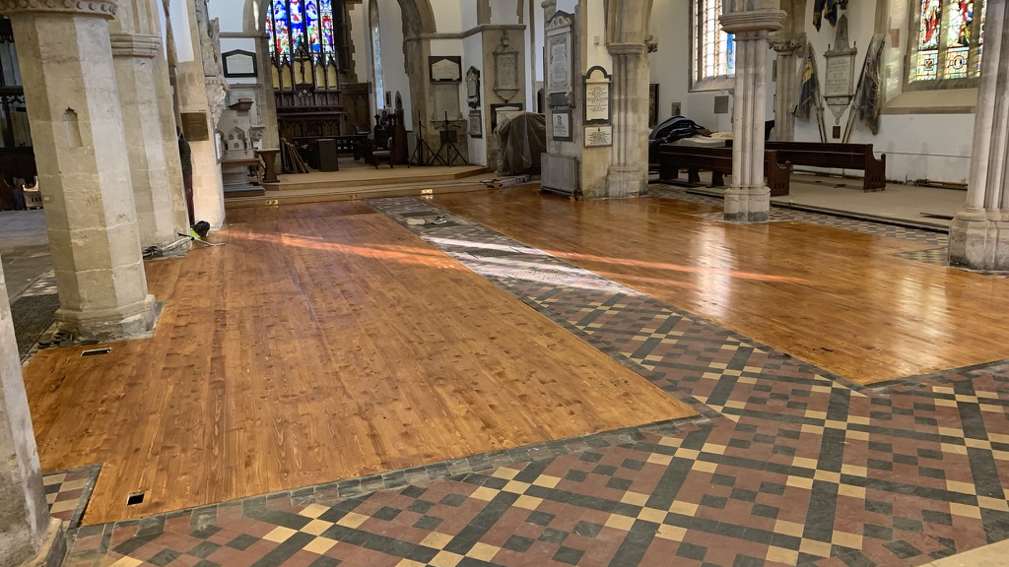

Slide 30
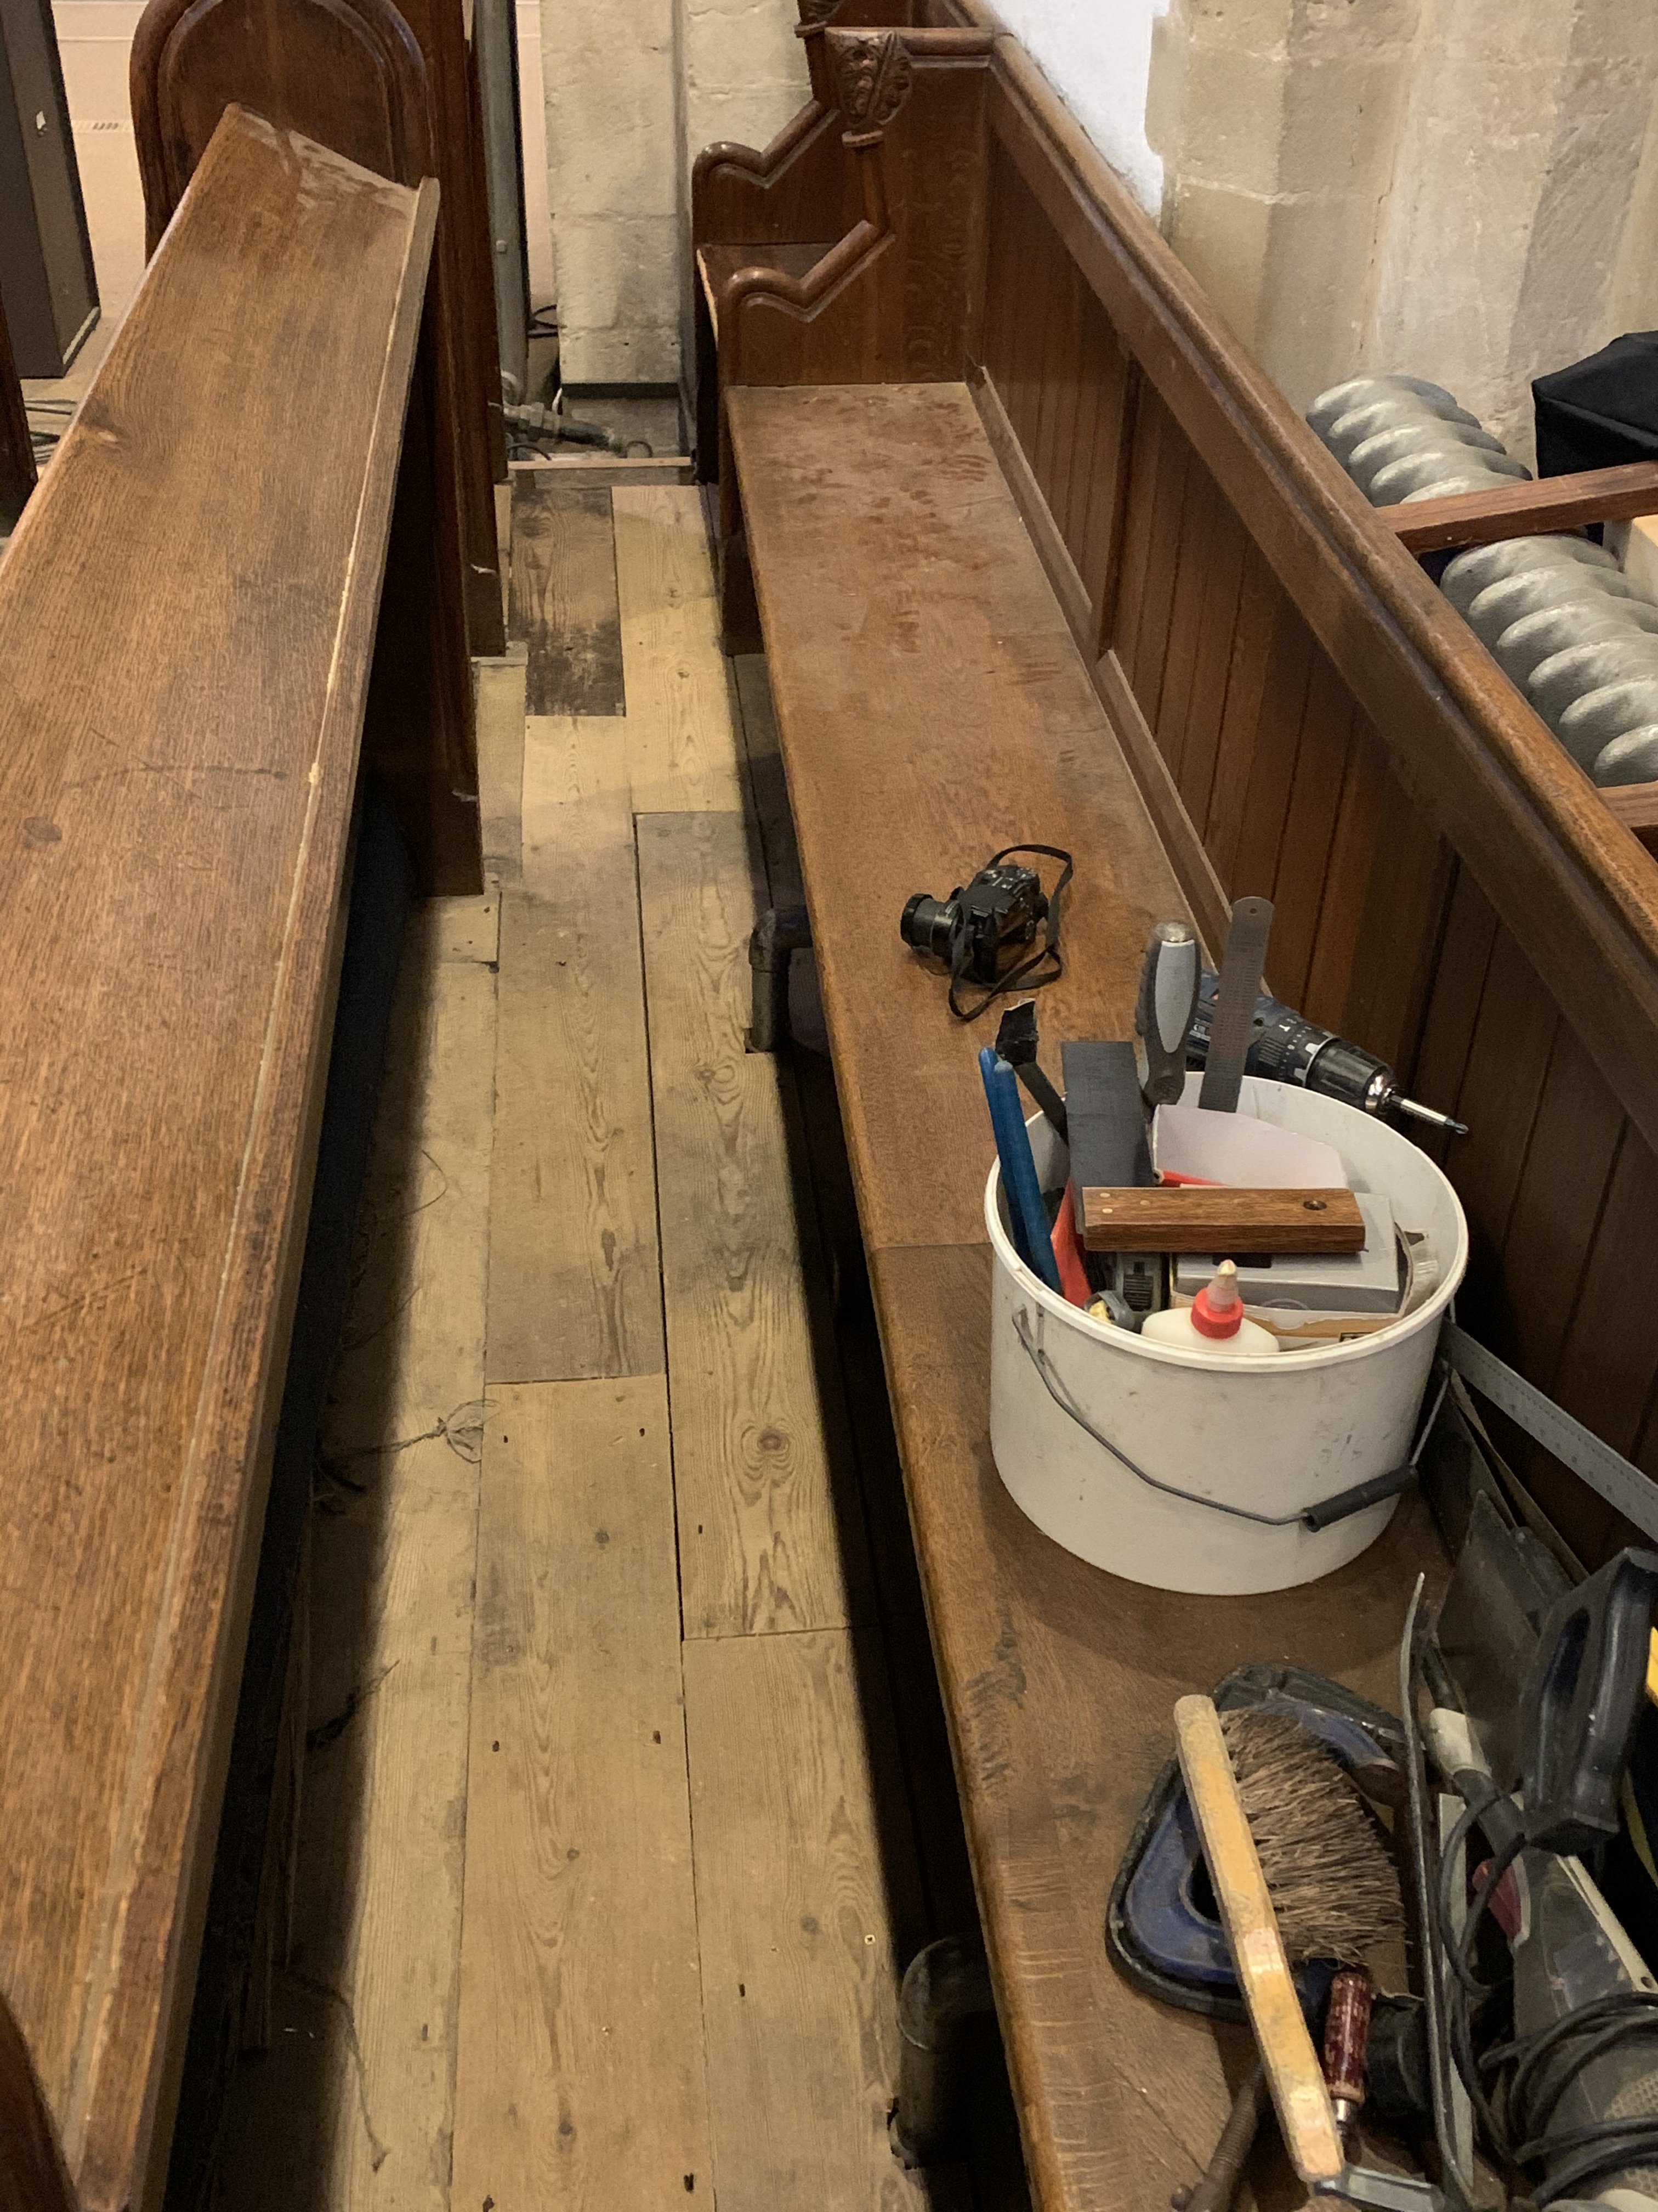
Floorboards replaced in choir pews

Slide 31
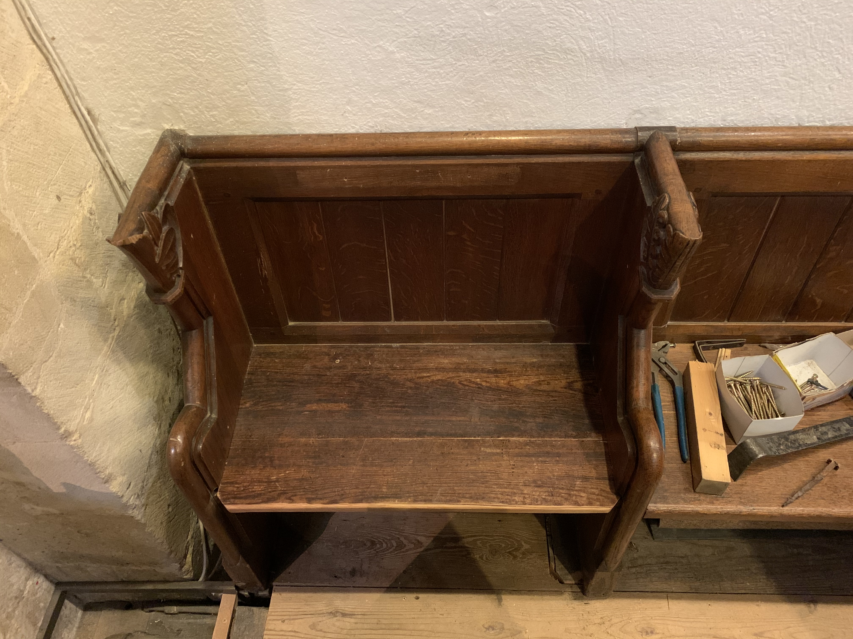
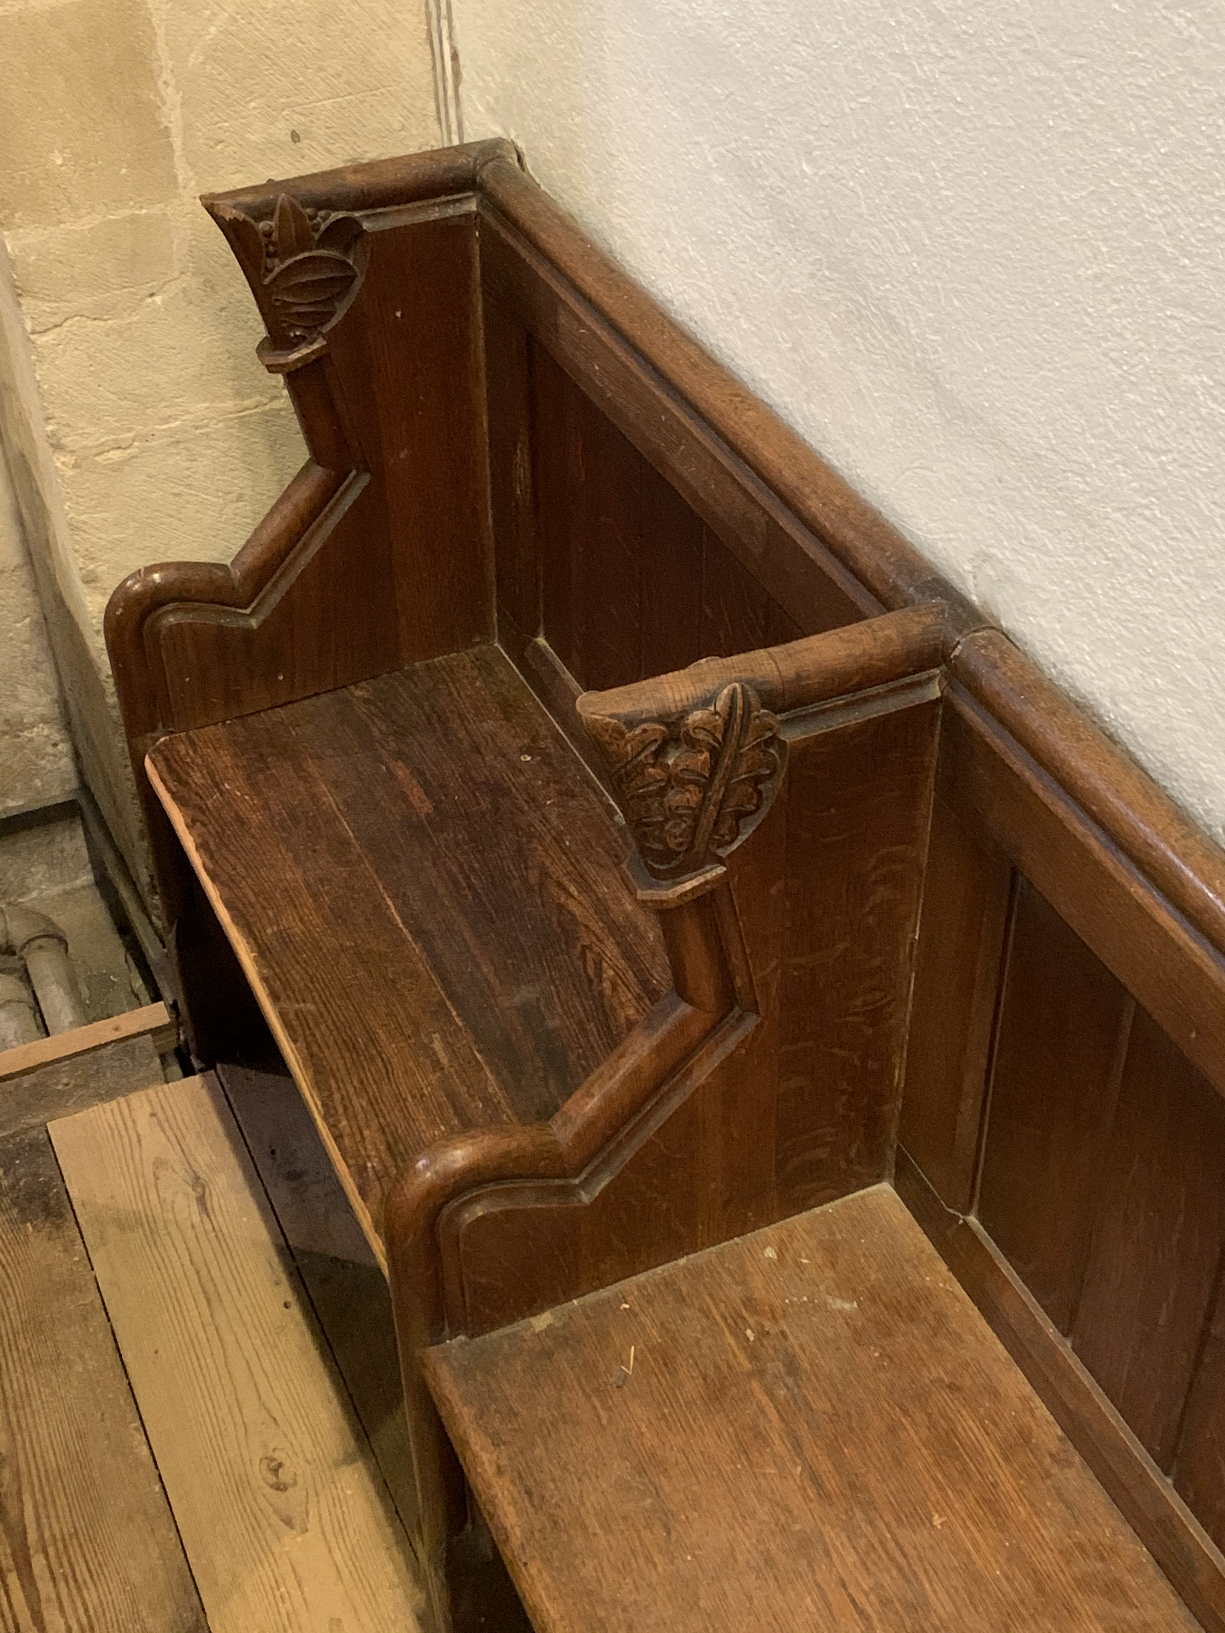
‘New’ seat in choir pews

